Slide 1
WaGILE
Navigating the Waterfall Agile Swirl as a BA

Slide 2
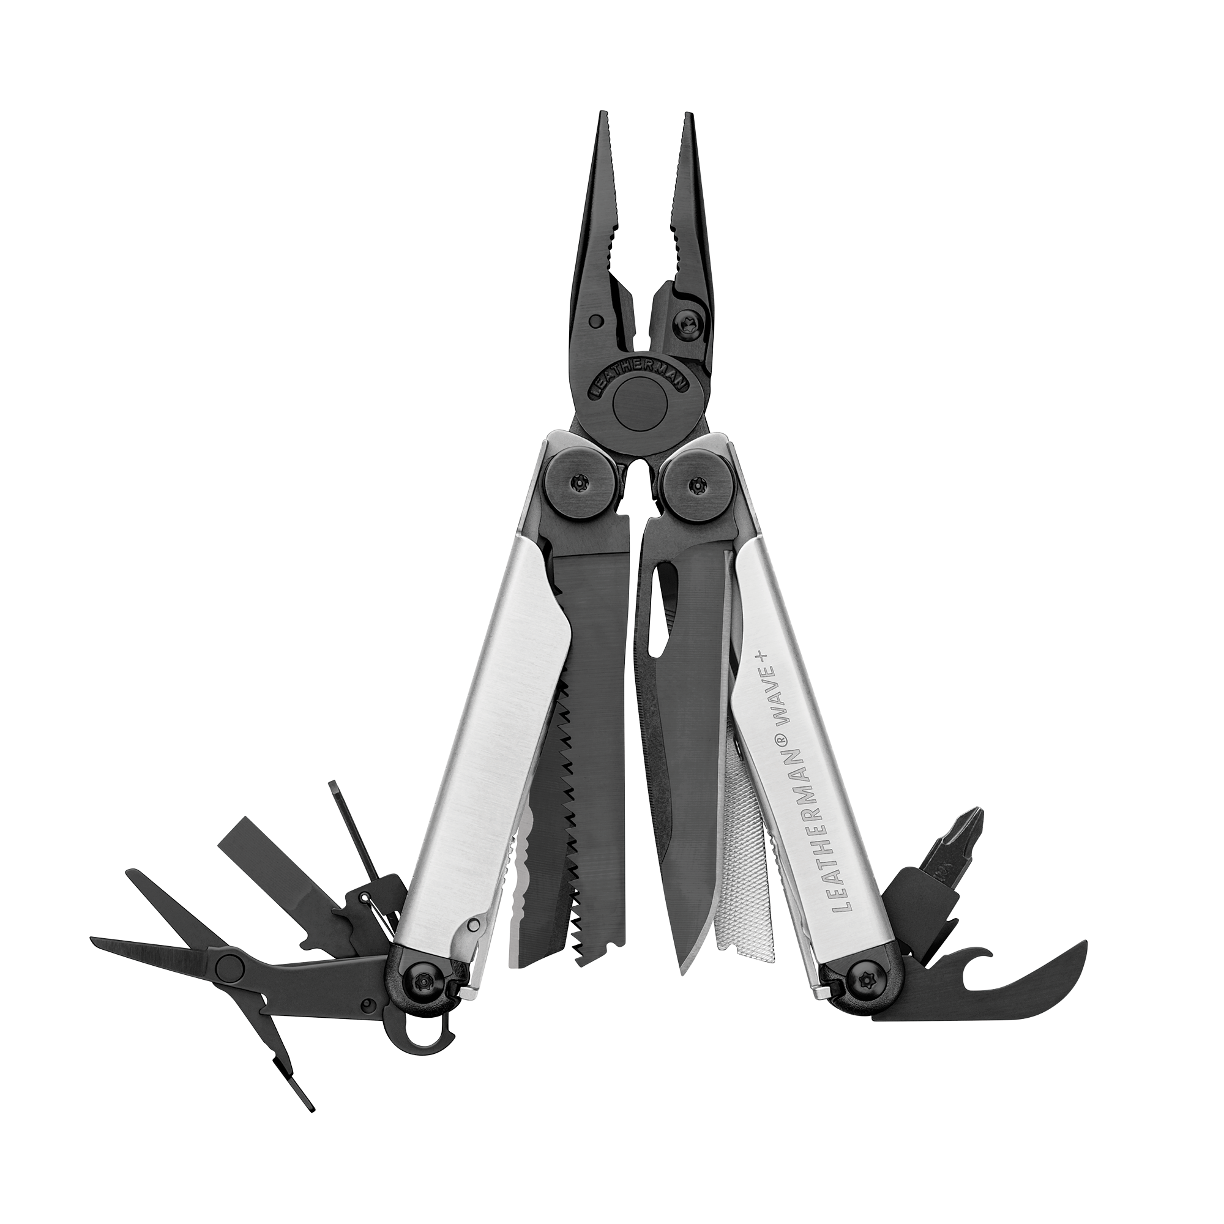
SZC
Shannon Z. Cross
Engagements:
Services and Software
Enterprise Strategic and Department Tactical
Business Architecture and Process
Business Development
Organizational Change Management
Roles:
Business Analysis
Project Management
Program Management
Product Owner
Department Leader
Entrepreneur
Sectors:
Private
Public
Government
Disclaimer: Opinions expressed are my own, and are not reflective of my employer. Some may be bothersome to the stronger adherents of waterfall or agile frameworks.

Slide 3
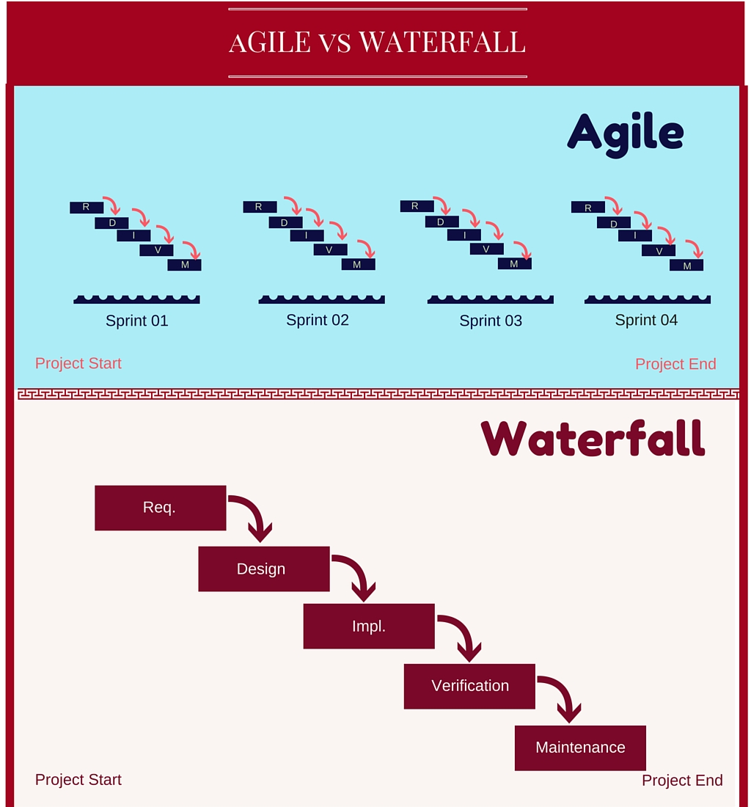
FYI
For Your Information
Agile for increased complexity and uncertainty, adaptive
Emerging scope and UAT throughout
Incremental
Flexibility
Waterfall for less complexity and uncertainty, rigid
Planning First and Validation/UAT at the End
Deadline
Budget
Agile used in areas outside of software development:
OCM
Marketing
Startups
Services
Cross-field Mapping
Waterfall Agile Translations
Scaling the wall between Executives and Team
Source: https://www.ukashturka.com; Author: Derrica Pitts; Posted: Tue, Sep 25th 2018

Slide 4
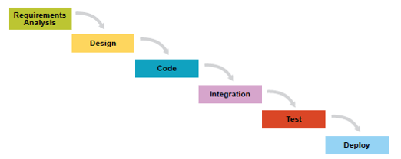
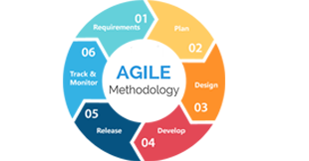
WAGILE
Waterfall and Agile in Cross-functional Programs (Example CAS PMO)
Idea
Stage
Project
Initiation
Planning
Execution
Closure
Operations
Intake
1. TRADITIONAL: Follows a “waterfall” approach or linear sequence approach.
Traditional
May combine both Traditional and Adaptive approaches where needed
Example
Useful when precise requirements are known.
Hybrid
2. ADAPTIVE:
Follows an “agile” or iterative approach.
3. Bimodal (a.k.a. WAGILE): Is the “practice of managing two separate, coherent modes of delivery, one focused on stability and the other on agility”
Gartner, Inc.
Adaptive
Example
Useful when an evolving solution and collaborative efforts are required.

Slide 5
WAGILE
Waterfall and Agile in Cross-functional Programs (Example CAS PMO)
Idea
Stage
Project
Intake
Initiation
Planning
Execution
Closure
Operations
DEFINITION: Processes “to develop the course of action required to attain the project objectives”. Approval of each iteration is required to move to the next stage or project execution. Defined outcome from this should yield an Minimal Viable Product (MVP).
STAGE GATES: Approve each Planning Phase (Steering Committee)
AGILE PROJECT MANAGEMENT
Plan
Build
Test
Stages Gates occur during process
Iteration 0
Design
Implement
Close
HYPOTHESIS
Opportunity Areas
Project Plan
VISION
Proof of Concept
Prototypes
MODEL
Product Roadmap
Architecture Plan
Epics and Stories
Confidence LOW
RISK HIGH
INVESTMENT LOW
ESTIMATES ROM
Confidence HIGH
RISK LOW
INVESTMENT HIGH
ESTIMATES DETAILED
CAS is a division of the American Chemical Society.
Copyright 2019 American Chemical Society.
All rights reserved.

Slide 6
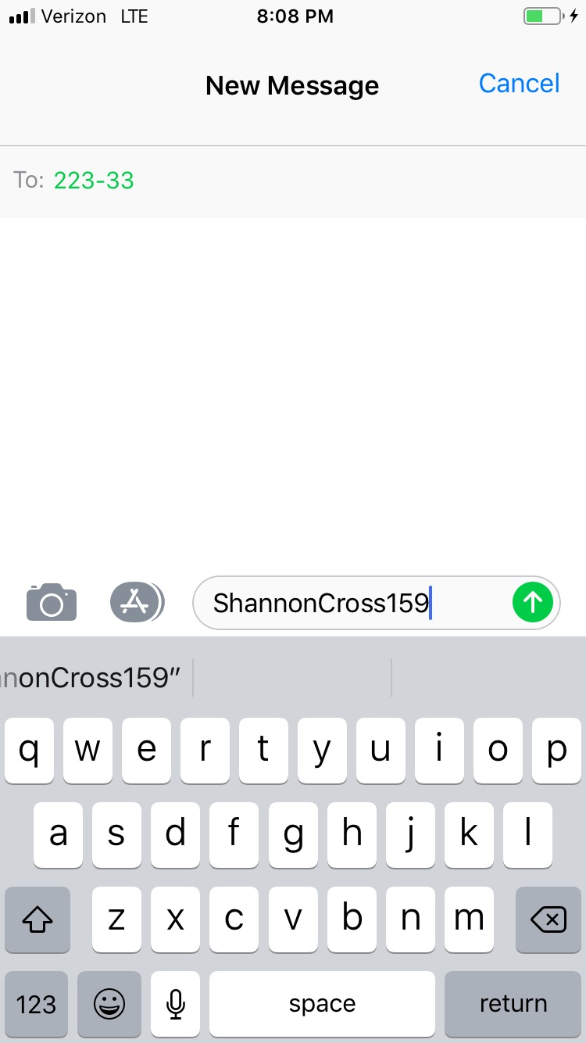
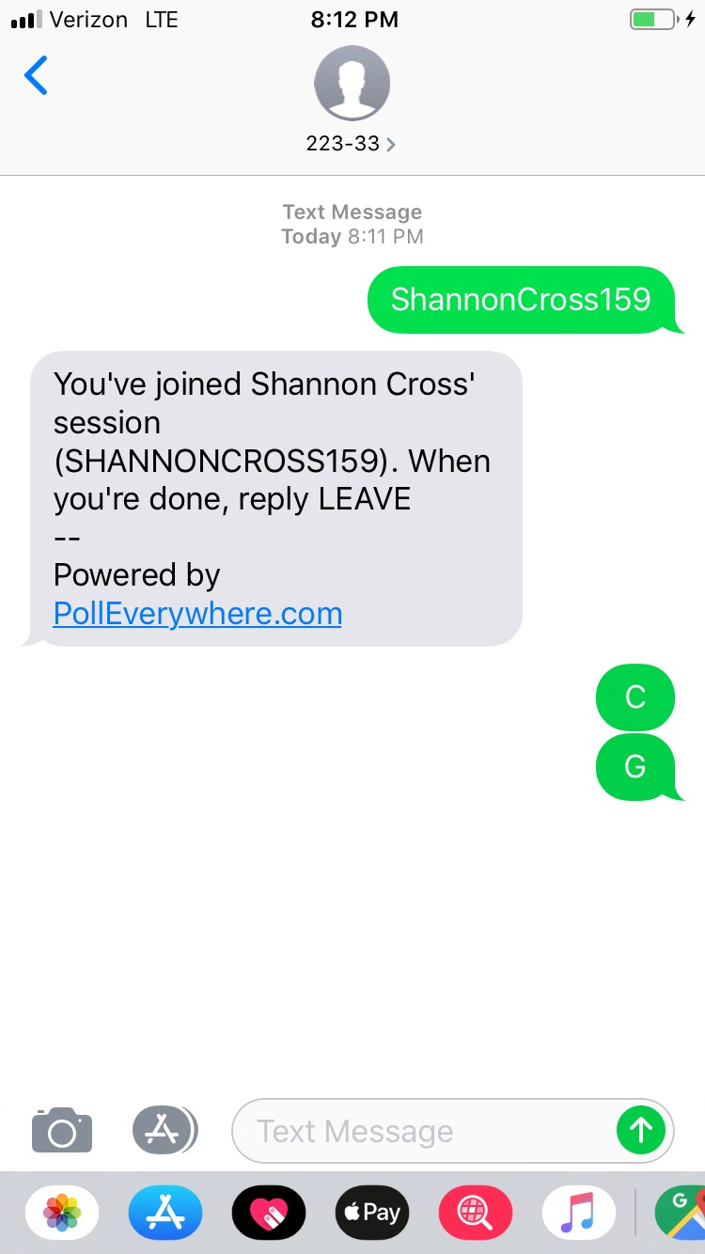
RSVP
Please respond to the poll
Text ShannonCross159 to 22333
Then text the letter or letters that apply – one at a time

Slide 7
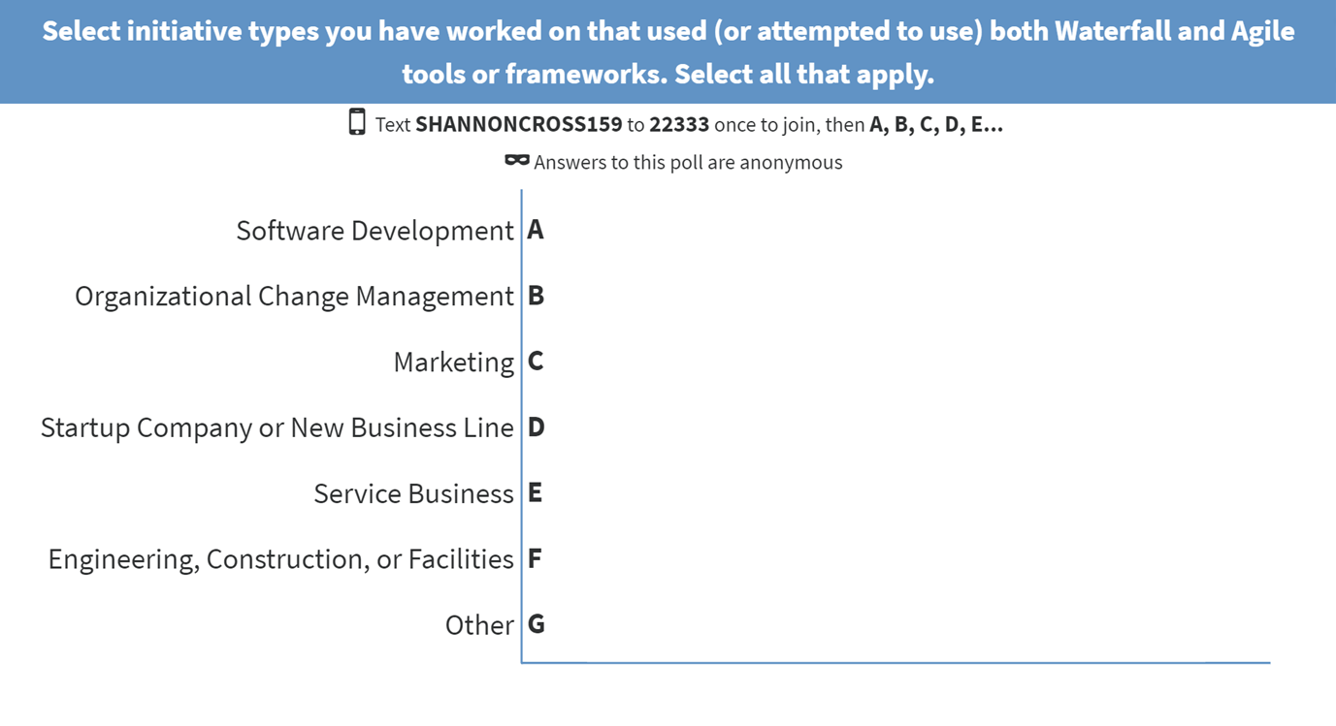
RSVP
Text ShannonCross159 to 22333
Then text the letter or letters that apply – one at a time
Please respond to the poll

Slide 8
TY
Thank You!
Let’s see the results
PollEv.com/shannoncross159
https://www.polleverywhere.com/multiple_choice_polls/IfslZsh4f5xJIzAy0a6fj

Slide 9
ID
Identify
Stakeholders – role, actual human person name, power and impact
Business Goal – value proposition and/or strategic outcome
Technical Requirements – scope and specific end user requirements
Timeline – is there a time goal for completion
Budget – how much money do you have to work with
Tools, Processes and Techniques – based on industry or Perspective
Common set of expectations – if ambiguity is to be the norm, be clear about that
Thresholds – what is the tolerance for changes and risk
Agreements – stack hands on all of the above
If you cannot ID all these things, or not completely, at the start of an initiative (which is normal) then map what you can and be comfortable with Emergent Change.
Eliciting all requirements at the beginning is aspirational, not a practical manifestation of any project framework.

Slide 10
OCM
Organizational Change Management
Current State
Transition
Future State
Plan/Tactics Emergent Change
Strategy
New Reality
Best Practices
Tools:
Stakeholder matrix/register and personas
Roadmaps with milestones/deadlines
Benchmarking
Surveys and feedback loops
Agreement on change and risk thresholds
Kanban board
Communication plans

Slide 11
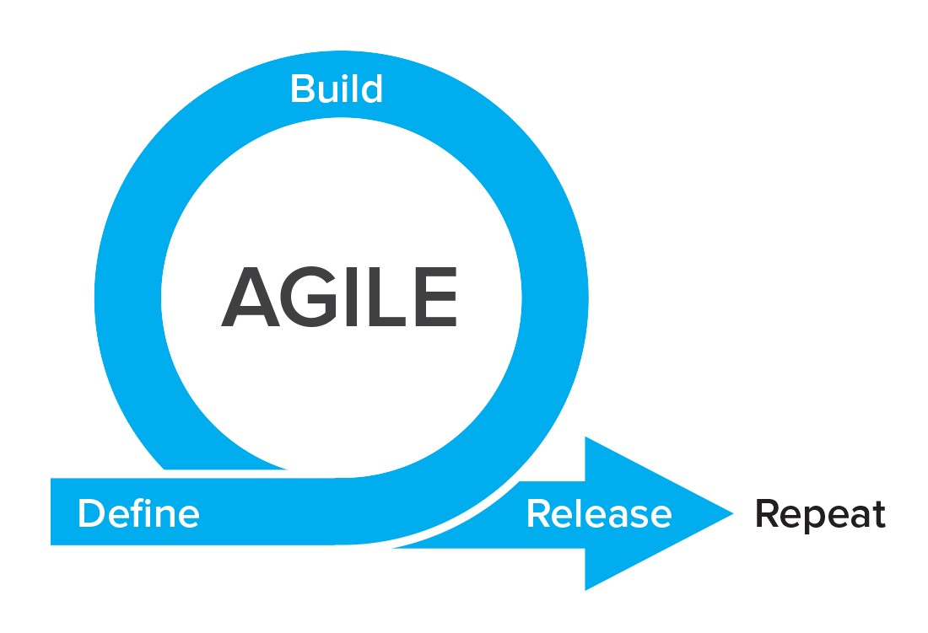
PR
Public Relations and Marketing
Tools:
Sprints
Roadmaps with milestones/deadlines
Wireframes
Surveys and customer driven development
Agreement on change and risk thresholds
Budget
Responsive communication plans to customers

Slide 12
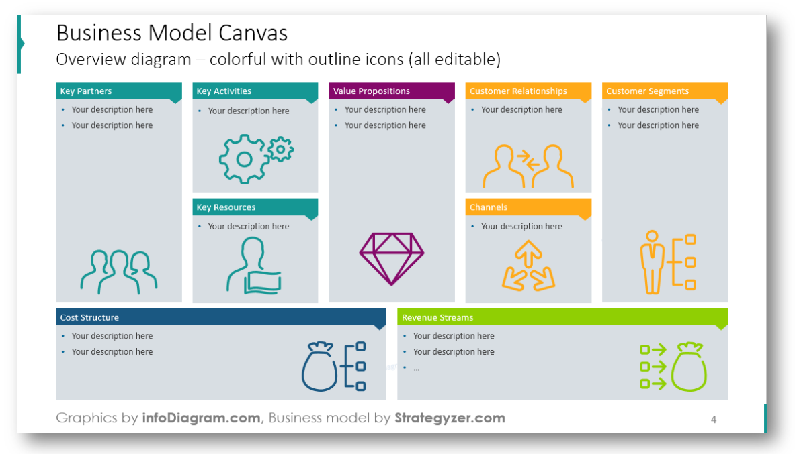
S/U
Startups
Tools:
Business architecture and process mapping (Business Model Canvas)
Industry knowledge
SLAs and OLAs
Rapid customer feedback
Use cases and workflow mapping
Agreement on change and risk thresholds
Stakeholder management
Business cases
Prioritization
Organizational models
Systems thinking
Kanban
Scrum

Slide 13
SVCS
Services (Custom Solutions)
Tools:
Industry knowledge
SLAs and OLAs
Interviews
Process Analysis
Workshops
Rapid customer feedback
Acceptance criteria
Agreement on change and risk thresholds
Stakeholder management
Systems thinking
Kanban

Slide 14
TR
Translating Waterfall Agile
Milestones for Executives as Program Increments or Releases
Change Management as Product Backlog Prioritization
Rolling Wave as Iterations
Time or Size Estimates as Velocity
Deadlines as Timeboxing
Budgets as Budgets
Lessons Learned as Retrospectives
Definition of Done as a universal concept

Slide 15
Q&A

Slide 16
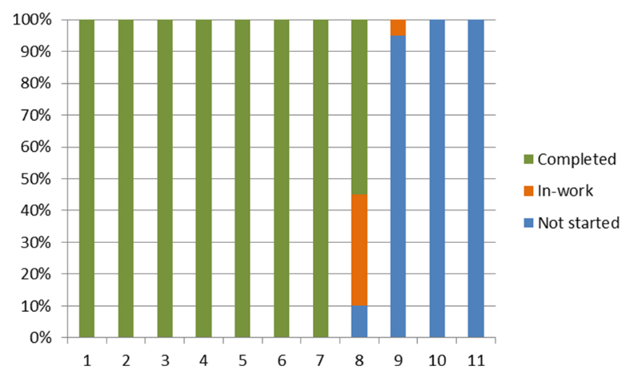
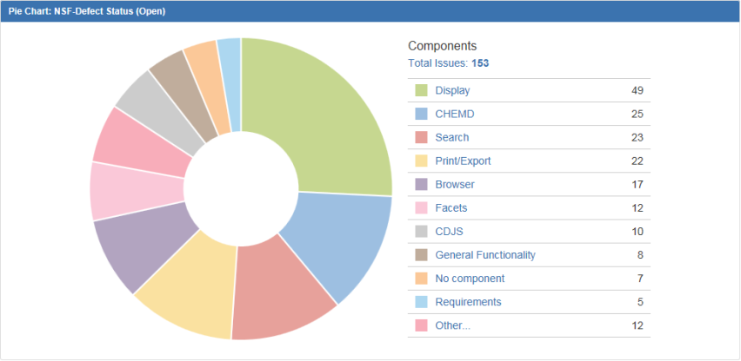
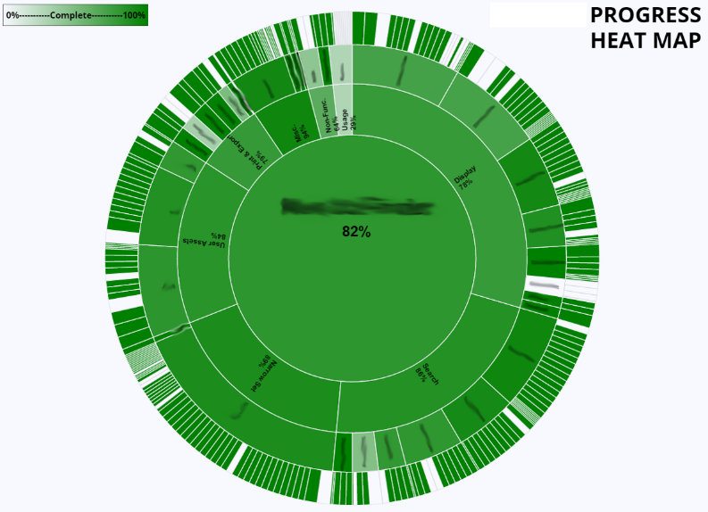
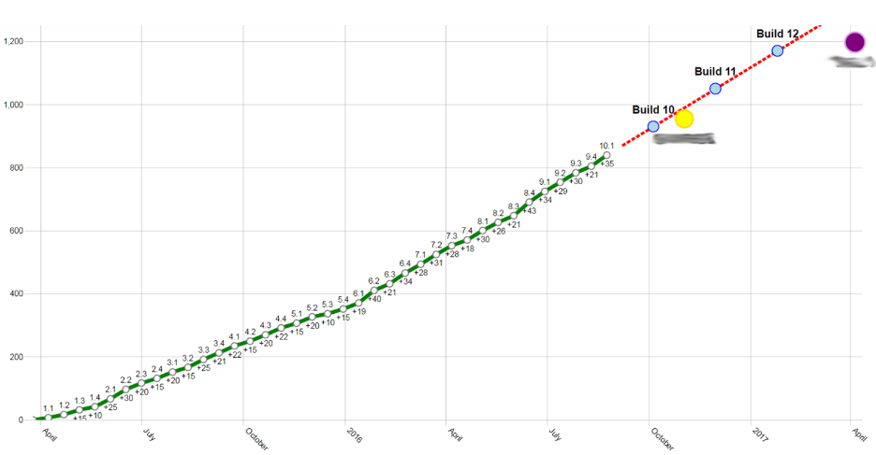
Management Dashboard

Slide 18
SDLC

