Slide 1
Run Meaningful Meetings
Randy Babb
Columbus Chapter of the IIBA
January 15, 2020
Notes:
Print Poster Size:
Both Agendas
Issues
Decisions
Actions
Bring:
Business Cards
Laptop Meetings Suck Book
Converter cable Michael Wilkinson Book
Power cable ELMO
Mouse
Remote Slide Advance
Pens
Post-it Notes
Candy
Effective Facilitator books and Cheat Sheets
Lean Coffee Book

Slide 2

Introduction

Slide 3
Randy’s Point of view on meetings
Great Facilitators … Great Meetings … Great Results!
Leading Strategies Inc.
  Michael Wilkinson
  Taking Classes for 7 years
International Institute for Facilitation (INIFAC)
  Certified Master Facilitator certification
  39 in the world
  Completed Part 1 of 2

Slide 4
LSI’s Facilitator Methodology
Focusing the Group
Power of the Pen
Getting Session Started
Preparing for Success
Closing the Session
Information Gathering
Managing Dysfunction
Consensus Building
Keeping Energy High
Agenda Setting

Slide 5
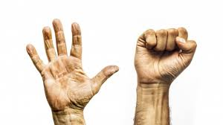
Ground Rules
When you are voting:
Fist
or
Five
Disagree
Need To Discuss More
Agree
Ready To Move On

Slide 6

Ground Rules
If you have heard enough, call an ELMO

Slide 7
Ground Rules
ISSUES
DECISIONS
ACTIONS

Slide 8
By Fist (Disagree) or Five (Agree), vote on the following statement.
I hate meetings!

Slide 9
‘I HATE Meetings’ Agenda
Why Are Meetings So Bad?
What Can We Do About It?
How Do Leading Companies Deal With Meeting?
  Google
  Facebook
  Apple
  Amazon
Lean Coffee Meetings
Randy’s Special Limited Time Offer
Approve of the Agenda? Fist (Disapprove) or Five (Approve)

Slide 10
Why Are Meetings So Bad?
Suggest a Team Competition By Table
  “Dump and Clump” Activity
    Each Table Will Create As Many Ideas As Possible
  “Last Table Standing” Activity
    Going Round Robin Each Table Will Introduce Unique Ideas
    Last Table With Ideas Wins
Approve of this Competition? Fist or Five

Slide 11
Dump and clump
Elect a Captain for your table
Captain get some Post-Its, a Marker and a Card
Captain return to your table and appoint a Scribe
Scribes when I say “Go” write One (1) Idea per Post-It
Table will have 3 minutes to generate ideas
Scribe: If the top is not on your pen at 3 minutes, your table will forfeit two ideas

Slide 12
Does Every Understand What To Do?
Everybody close your eyes
If I were at your table and said “The room was cold”, the Scribe would _________.
Go

Slide 13
Last Table standing
Captains bring your table’s Post-Its up front
Line up in the order of the card you drew (A to K)
1st Captain read one of your table’s ideas and give it to me
I will put it on the board
2nd Captain read an idea and give it to me
The Group will decide if it is unique
  If it is, I will put it on the board and 3rd Captain will start
  If it is not, 2nd Captain will read and give me another idea
  When a Captain runs out of ideas, they will sit down
Last Captain Standing’s table wins

Slide 14
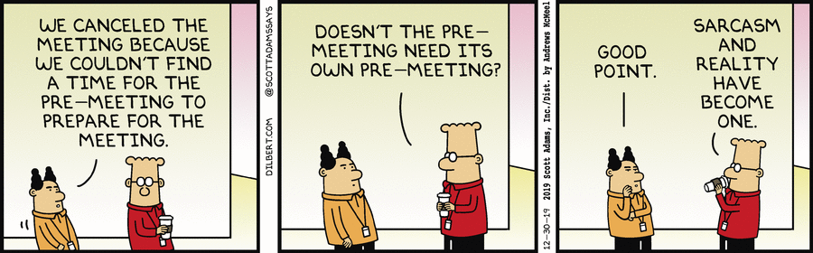
Monday December 30, 2019

Slide 15
What Can we do about it?
Focusing the Group
Power of the Pen
Getting Session Started
Preparing for Success
Closing the Session
Information Gathering
Managing Dysfunction
Consensus Building
Keeping Energy High
Agenda Setting

Slide 16
Preparing For Success
The Method
  Purpose, Product, Agenda, Probable Issues, and Business Area
The People
  Sponsor, Planning Team, and Participants
The Logistics
  Location, Schedule, Materials, and Meeting Notice
Know Your Process Cold!
  Order of the facilitation processes
  Process technique to gather information
  Starting Question for each process
  Recording method to document information
  Supplies required for process
  Timing and duration for each process

Slide 17
Getting the session started
Inform
  Inform the participants about what is going to happen
Excite
  Get the participants excited by giving them a clear vision of the result to be achieved and its benefit.
Empower
  Empower the participants by discussing the important role they play and the authority they have.
Involve
  Get the participants involved by having them speak ASAP
Ground Rules and Parking Boards

Slide 18
Focusing the group
Checkpoint
  Review
  Preview
  Big View
Warm-up the Group
PeDeQs Directions
  Purpose for the activity
  Example: you start it, the finish it
  General Directions
  Specific Exceptions
  Ask for Questions
  Ask your Starting Question

Slide 19
The Power of the Pen
Use It, Don’t Abuse It
  Write first, discuss second
  Write what is said, not what you heard
  Ask speaker to headline it
Make It Theirs
  Write so they can read it
  Edit by adding
  If more than one person tries to speak, order the speakers
  Avoid lulls
Seven Deadly Facilitation Sins

Slide 20
Information gathering
Types of Questions
  Direct Probe
  Indirect Probe
  Redirection
  Playback
  Leading Questions
  Prompt Questions
  Tag Questions
  Float an Idea
Listing, Brain-storming, Grouping, and Prioritizing

Slide 21
Managing Dysfunction
Any activity by a participant which is consciously or unconsciously a substitution for expressing displeasure with the Process Used Content of the session, or an Outside Factor unrelated to the session
Only Three Causes
  Don’t Understand Each Other
  Have Different Life Experience
  Don’t Like Each Other
Separate the Symptom from the Root Cause
Prevention Strategies
Detection Strategies
Resolution Strategies

Slide 22
Consensus building
“I can live with that and support it.”
Why People Disagree
  Haven’t Heard One Another
  Different Values
  Past History
Consensus Strategies
  Delineation
  Strengths and Weaknesses
  Merging Alternatives
  Ranking/Weighting
  Converging Solution

Slide 23
Keeping the energy high
Opening Words establish a base line energy level
Re-establish energy level after each Break
An Activity Every 30 Minutes Minimum
  Unless Many Remote Participants Then Every 15 – 20 Minutes
Recharge Activity
“Lullaby Times”
  10:30 to 11:00 AM
  1:30 to 2:00 PM
  3:00 to 3:30 PM

Slide 24
Closing the session
Review
  Activities
  Session Purpose
  Objectives
  Issues, Decisions, and Actions
Evaluate
  Process
  Results
Close
  Thank participants
  Next Steps
Debrief the Sponsor and Project Team

Slide 25
Agenda Setting
Adapt Agenda To Address the Need
Agenda From Scratch
  Identify critical questions
  Develop preparation questions
  Order preparation questions
  Convert questions to agenda items
  Prepare detailed agenda
Agenda Models

Slide 26
‘I Love Meetings’ Agenda
What Makes Meetings So Good?
What Can We Do To Make Them Even Better?
How Do Leading Companies Deal With Meeting?
  Google
  Facebook
  Apple
  Amazon
Lean Coffee Meetings
Randy’s Special Limited Time Offer
Approve of the Agenda? Fist (Disapprove) or Five (Approve)

Slide 27
What Makes Meetings So Good?
Suggest a Team Competition By Table
  “Dump and Clump” Activity
    Each Table Will Create As Many Ideas As Possible
  “Last Table Standing” Activity
    Going Round Robin Each Table Will Introduce Unique Ideas
    Last Table With Ideas Wins
Approve of this Competition? Fist or Five

Slide 28
Dump and clump
Elect a Captain for your table
Captain get some Post-Its, a Marker and a Card
Captain return to your table and appoint a Scribe
Scribes when I say “Go” write One (1) Idea per Post-It
Table will have 3 minutes to generate ideas
Scribe: If the top is not on your pen at 3 minutes, your table will forfeit two ideas

Slide 29
Does Every Understand What To Do?
Everybody close your eyes
If I were at your table and said “The room was cheerful”, the Scribe would _________.
Go

Slide 30
Last Table standing
Captains bring your table’s Post-Its up front
Line up in the order of the card you drew (A to K)
1st Captain read one of your table’s ideas and give it to me
I will put it on the board
2nd Captain read an idea and give it to me
The Group will decide if it is unique
  If it is, I will put it on the board and 3rd Captain will start
  If it is not, 2nd Captain will read and give me another idea
  When a Captain runs out of ideas, they will sit down
Last Captain Standing’s table wins

Slide 31
Monday December 30, 2019

Slide 32
What Can we do To Make Them Even Better?
Focusing the Group
Power of the Pen
Getting Session Started
Preparing for Success
Closing the Session
Information Gathering
Managing Dysfunction
Consensus Building
Keeping Energy High
Agenda Setting

Slide 33
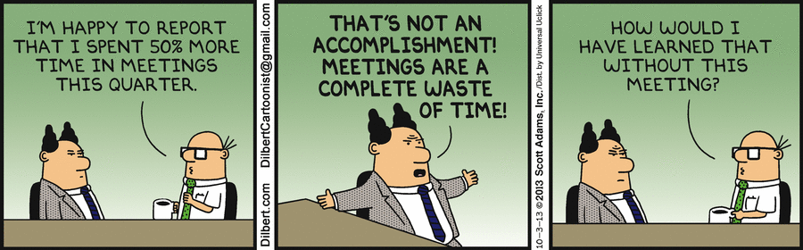
Thursday October 3, 2013

Slide 34
Google Meetings
Problems:
  Office politics often dictated meeting decisions
  An idea was adopted because it sounded good
Google Solution:
  Every decision is backed up by data
    Decisions must be tied together with hard numbers
Example:
  An idea is now adopted because it is 20% better than another idea

Slide 35
Google Meetings
Keep meetings small
Use agendas
Make decisions without meetings
  Don’t hold meetings just for the sake of making decisions
Assign note-takers and decision-makers
  To keep meeting focused and team members updated
Hold ‘micro-meetings’
  Marissa Mayer, ex VP of Search Products, allowed 5 and 10 meetings to be scheduled with her
Use a visible, physical clock to count down time

Slide 36
Facebook Meetings
Is meeting be held to “make a decision or have a discussion”?
Sheryl Sandberg, COO, crosses off meeting items as meeting progresses
  When all items crossed off, meeting ends

Slide 37
Apple Meetings
At the end of every meeting, every decision is assigned to a meeting participant, who is responsible for that decision
  Responsibility is defined
    Overlook team members who implement decision?
    Solely responsible to act on decision?
  Responsible person reports back at subsequent meetings
Meeting participants need a reason to attend
  Steve Jobs threw out meeting participants who didn’t have a reason to be in the room
Steve Jobs challenged participants to defend their ideas

Slide 38
Amazon Meetings
“We don’t do Powerpoint (or any other slide-oriented) presentations” – Jeff Bezos 2018 stockholders’ letter
Six-page evidence-based narrative’ in “complete sentences and paragraphs to force a deeper clarity” is created and distributed ahead of every meeting
  Context of meeting or questions needing answered
  Possible approaches to questions
  Meeting participants’ approaches
  What’s the next step?

Slide 39
Amazon Meetings
Executives sit down for 30 minutes of silence at the beginning of the meeting to read the narrative
Empty chair in meeting room reminds participants of the customer

Slide 40
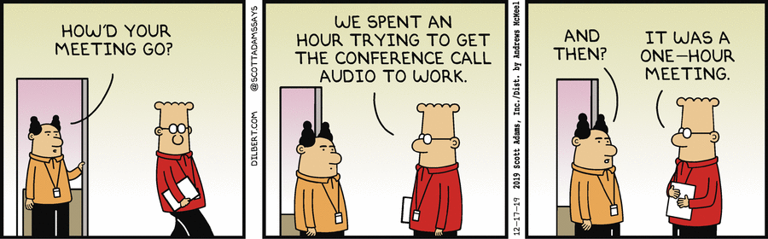
Tuesday December 17, 2013

Slide 41
lean coffee meetings
No Agenda Before Meeting
Participants contributes topic ideas at start of meeting
  No one must add a topic
    Think about and add topics during introductions
Each contributor elaborates on their topics
Participants individually vote on their top 2 or 3 topics
Highest vote getting topic is first discussed
Each topic time boxed (5 minutes) with chiming timer
Chime sounds stop talking, vote to continue or move on
  If majority vote to continue, time boxed (3 minutes)
  If not, move to next highest vote getting topic
Before end of meeting, gather takeaways

Slide 42

Rudimentary Lean Coffee Table: 4 Columns
Topics | Ongoing | Done | Epiphanies & Action Items
Next
IIII
Now
IIIIII
Discuss
IIIIIII
Epiphany
Next+1
II
Experiment
Next+2
I
Experiment

Slide 43
Retrospective Lean Coffee Table
Just The Facts | Δ Improve | + Went Well | Ongoing | Done | Experiments
Fact
IIII
Could’ve been better
III
Celebrate & Amplify
II
Now
IIIII
Discussed
IIIIII
Epiphany
Fact+1
II
Celebrate & Amplify
Could’ve been better
Experiment
Fact+2
I
Celebrate & Amplify
I
Experiment

Slide 44
Why lean coffee Is Worth Doing?
Engagement:
  Helps cover most important topics (to the majority)
Focus:
  Stops one topic from taking over meeting
Efficiency:
  Allows group to move on when they understand
Egalitarian:
  Captures what’s on people’s minds so that everyone is heard even if their topic is not discussed
Clarity:
  Real time feedback by the room limits rambling

Slide 45
How to lean coffee
Seven Basic Steps:
  Set up meeting table (< 1 minute)
  Introduce how Lean Coffee works (< 2 minutes)
  Invite attendees to introduce themselves (optional)
  Invite attendees to introduce their topics
  Vote on the topics
  Begin timeboxed discussion
  Invite takeaways

Slide 46
lean coffee mechanics
Facilitator
  Sets up table
  Ensures rules being followed
  Paying attention to ‘weak signals’ around table
  Not the ‘leader’ of the meeting
Tools
  Table
  Sticky notes
  Markers
Minimal Rules
Roman Voting

Slide 47
Effective Use Of lean coffee
Training
  Involve class in what they’re going to learn and how they’ll learn it
  Write down topics they want to learn and put in backlog
  Team votes on topic and timebox for segments
  Use timebox and Roman vote to check if class is satisfied with segment
    Check with UP votes, to see if they feel left out
    If moving on,
      Summarize what was covered
      Highlight options of what may be pursued at another time
      Seek takeaways from class before breaking and then starting next segment

Slide 48
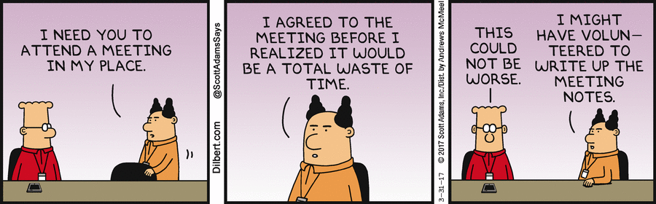
Friday March 31, 2017

Slide 49

Randy’s Special Limited Time Offer

Slide 50

LSI Webinars
marketing@leadstrat.com

