Slide 1
Fictional Test Data
Joshua Russell
Notes:
Thank you for registering to listen. This talk is about the role of test data in our stories.
Last time QA/Highway in Feb. A lot has changed ;D
Animations disclaimer
IIBA Columbus – June 10, 2020

Slide 2
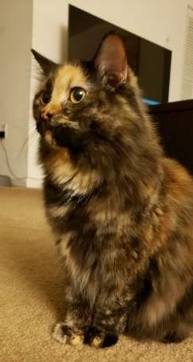
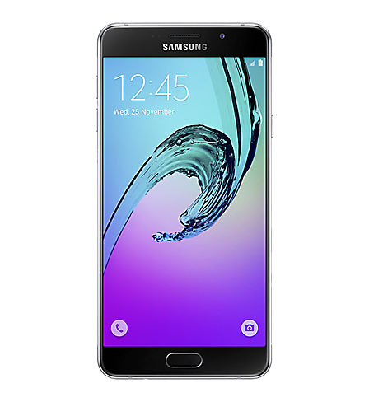
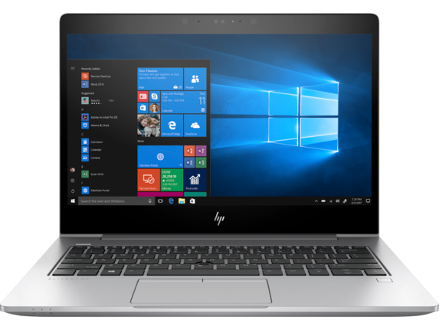
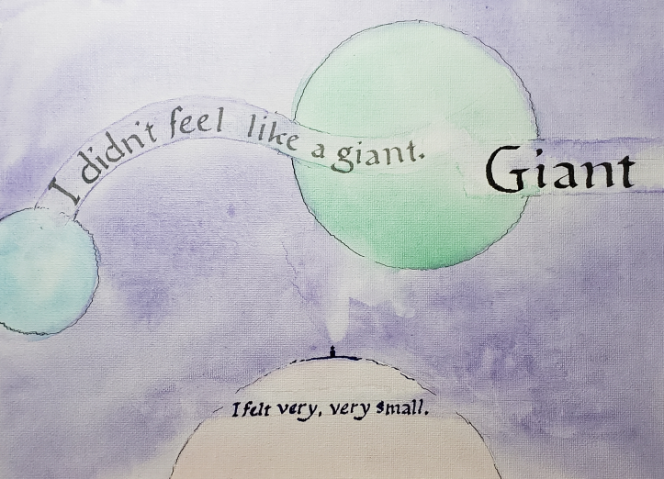
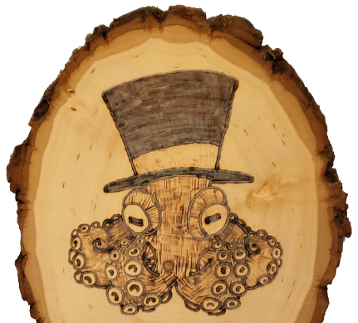
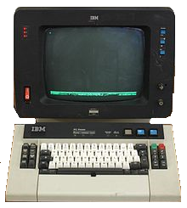
My Story
Notes:
Josh. Software developer, Columbus, AEP. Specialize – test automation. I’ve developed automation for applications on web, mobile, desktop, and mainframe platforms. Outside of the workplace, I’m an arts and crafts nut – I try to do a bit of everything. I have two cats – Precious and Allie. Columbus illustrator Nat Lovett.

Slide 3
Notes:
Contrary to the theme of this presentation, I’m not much of a reader. Still, I sensed some parallel between my experience as a reader and my experience in quality assurance. A person can be sensitive to the difference between an easy, accessible writing style, and writing that is denser and more challenging. This is something we should consider in the office.

Slide 4
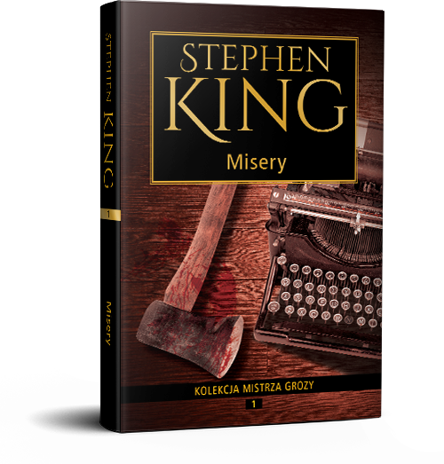
Accessibility is good
Notes:
Stephen King, and authors like him, are criticized for being too prolific, too popular, and too easy to read. There is a cynical attitude that the style of writing that makes some authors popular is lazy and greedy, but I think there is a great value in accessibility – These authors reach a wide audience, and that is good for the business model. In our work, this means wider value delivery and more collaborators.

Slide 5
Everyone should understand your work
Notes:
I propose that a guiding principle is underlying all of what we do as software developers, whatever it is that you do specifically: everyone should understand your work.

Slide 6
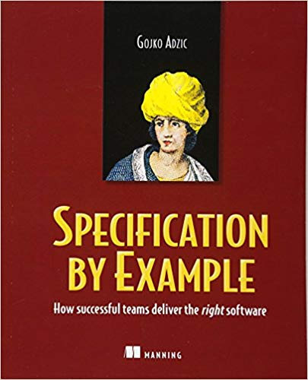
Notes:
Software developers strive to produce sensible models for other humans. Requirements designed for clarity, hammered out until they make sense. Code that is self-documenting, employs conventions, and uses design patterns so that others can comprehend. Tests tell detailed stories about software behavior - not only truthful, but easily understood. Cucumber and Gherkin are collaboration tools, and we use them because we value communication.

Slide 7
Tell A Story
Notes:
Today, let’s be storytellers! I want to talk about how we express details in our stories – not the step-by-step descriptions of actions that express the logic of an application, but the context for that logic. Story incomplete without details that establish what a character can do, or why they do it.

Slide 8
What is Test Data?
Master Data
Transactional Data
Analytical Data
Notes:
It would counter my point to say “test data” without explaining what I mean by that. I’m speaking broadly about information in our systems as it is employed by our tests. A helpful model categorizes the information in our systems with three categories: Master, transactional, and analytical data.

Slide 9
Master Data
Notes:
Most of the test data that we directly reference in our tests falls into the category of Master Data. Master Data includes business entities like users, products, accounts, and relationships.

Slide 10
Transactional Data
Notes:
Transactional data is basically what it sounds like – transactions. This includes purchases, orders, submissions, etc – records of interactions within our system. We don’t usually see transactional data represented in our tests, but it is intrinsically linked to Master data. The master data in our tests is further defined by the transactional data associated with it.

Slide 11
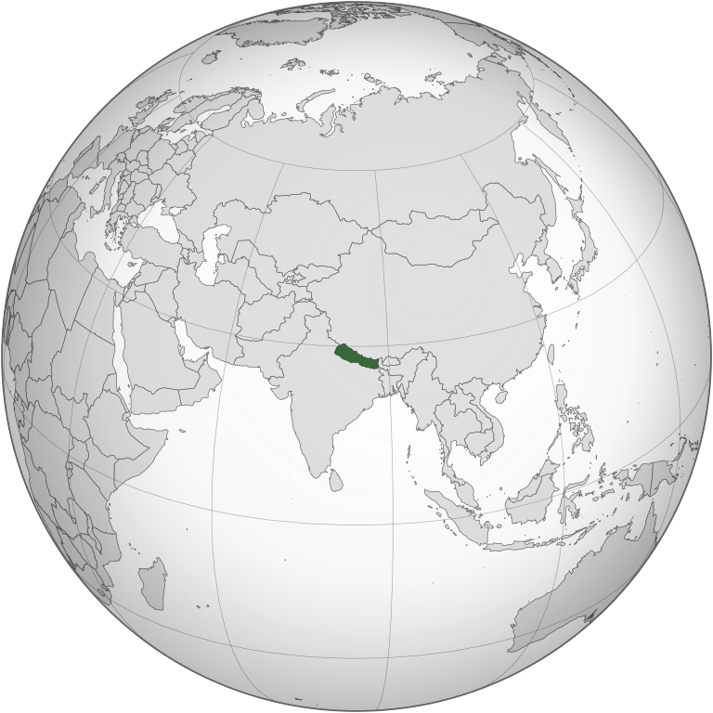
Analytical Data
Notes:
Analytical Data includes metrics and measurements used to make decisions. We gather this information from production systems and users. It might seem that we don’t include analytical data in our tests, but we do. This data supports a feedback loop in which we take information from the real world and use it to improve our testing - in the end, all our test data becomes a reflection of our analytics – I’ll come back to this.

Slide 12
Illegible Data
Username qauser12
Email automation1911211014@test.com
Name Qwerty A Mctvofgh
Notes:
Test cases often demonstrate the action of a test clearly, but not the details. Necessary user data attached to a test case often looks like this. I wouldn’t judge a book by it’s cover, but I’d like to read test data at a glance, and that’s not easy when we share users that look like this. We don’t know much about this user without looking it up - slinging SQL queries, booting up the app, whatever. QA deals in confidence, and I would like to proceed with my test feeling confident about this user, but I don’t recognize them, and I won’t remember them.

Slide 13
Dubious Claims to Fame
We remember the users that we share
We remember the users that don’t cause trouble
Notes:
We end up with superstar app users in the test environments – everyone knows em, everyone uses em. You need a user? Here’s the one that was given to me. Or worse… That user doesn’t work? Try this one. This one is safe… do we not understand the conditions that define our app behavior?

Slide 14
The Wards Family
Maury Wards
This character absolutely maximizes the loyalty points system, and has “more rewards” than other classes of user
Nora Wards
This character does not utilize the loyalty points system at all, and has “no rewards” of her own
Summer Wards
This character has earned just enough loyalty points to be a middle-tier member, and has “some rewards”
Notes:
This talk came from a simple test data experiment and the experience that followed. I needed to test a tiered loyalty points system, so I produced a family of users which met my needs – The Wards Family. <explain bullets> I found myself re-using the Ward family in other tests for months – I could remember them, and I understood what made them special.

Slide 15
Character Study
Notes:
Puns are fun, and the users we’ve proposed so far are neat, but so far, we have only scratched the surface. How do we design users that are realistic and relatable?

Slide 16
Something Missing
As a user
I want to mark my favorite store
So that I can easily order products for in-store pickup
Notes:
I often feel that something is missing in user stories that I see. <anim>. Right there. This doesn’t explicitly encourage us to consider the different real-world people who will interact with our software. Let’s say that I tested this feature with a user, and it works – great. What about Dan? Dan doesn’t shop in-store, ever.

Slide 17
Personas
Design software for specific users, not some generalized user
Use personas to represent specific users throughout development
Notes:
Alan Cooper, The Inmates Are Running The Asylum. We can only be successful if we design our software for specific users. We don’t want all users to be somewhat satisfied – we want specific users to be completely satisfied. Use personas - hypothetical archetypes that represent actual users through the software design process. UX designers employ personas to infer the needs of real-world users and design solutions that will address them. Business Analysts can employ personas to create context for user stories and app behavior. Quality analysts, can use the same personas to drive test case design and execution. If you use personas in your workplace, please share in chat.

Slide 18
Summer Wards
Lives in Seattle, WA
Age 20
Occupation: Sales
Archetype: Social Media Junkie
Motivators: Status, Cost
Loyalty Tier: “Earner”
Technological skill: Advanced
Notes:
If I expanded a member of the Wards family into a full persona, it might look like this. We include a little something about who she is, where she is, her motivations, and how she interacts with our system.

Slide 19
Personality
Make the user feel like a real, relatable person
Emphasize features that matter to the user
Imagine how the user will experience with new features
Notes:
A persona should include personal information about a user, even seemingly irrelevant information like a picture, name, age, career, etc - to make them feel like a real, relatable person. Thinking about a real human being will help us understand which features matter to the user, and how the user will experience these new features, to design test cases which support them.

Slide 20
Location
GPS
Time zones
Legal requirements
Notes:
Geographic location is also important and should inform our tests. Software might behave differently depending on the user’s specific GPS location, local time zone, and even legislation. A user may be directed to nearby store locations or use a specific feature while in-store. Our software may behave differently depending on time and date, for example, delivery estimates, or transaction cut-off times. Our software may need to accommodate laws that make it illegal to do business across geographic boundaries, or to do business differently. California Consumer Privacy Act.

Slide 21
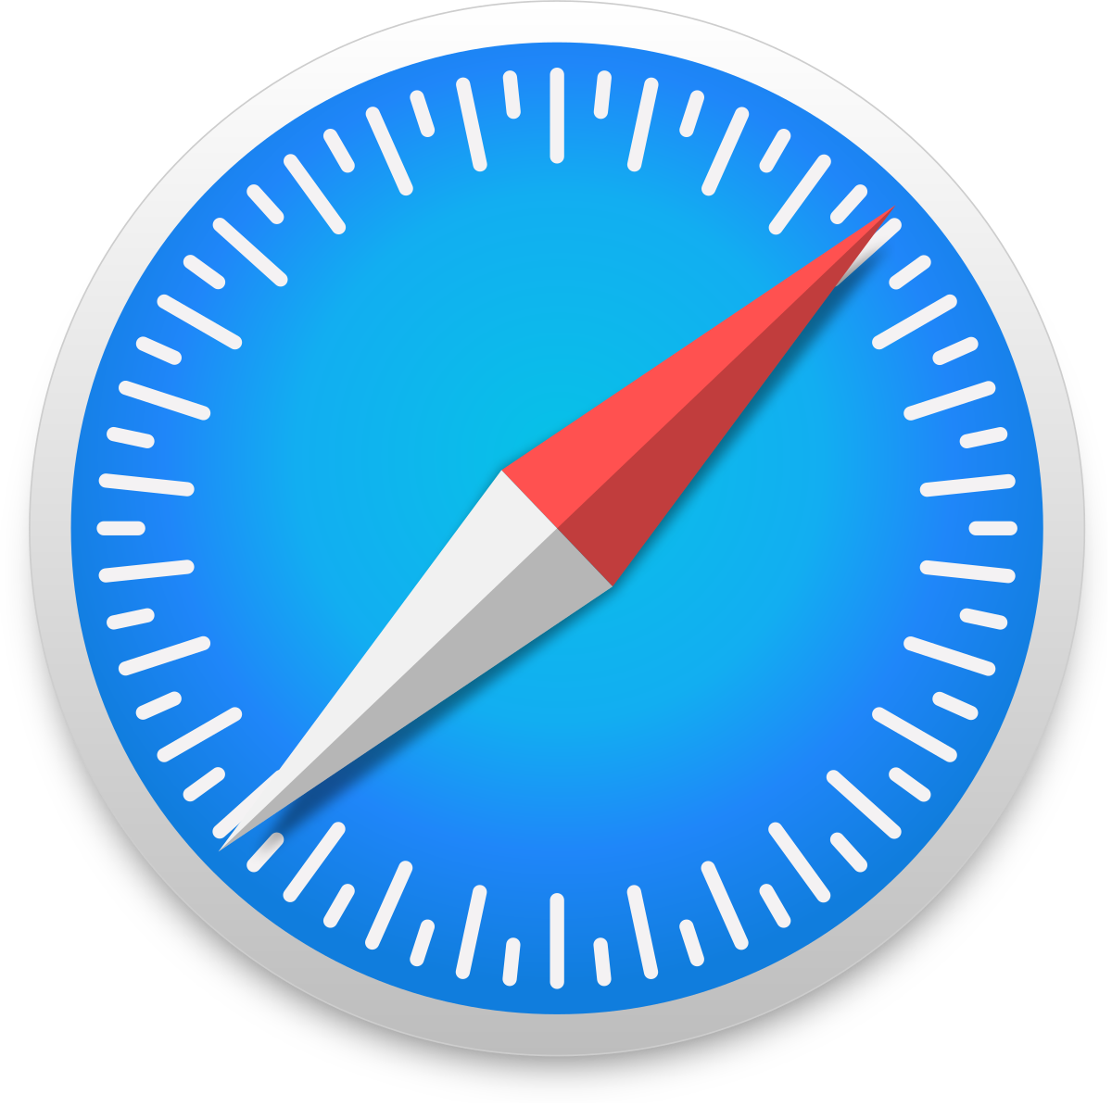
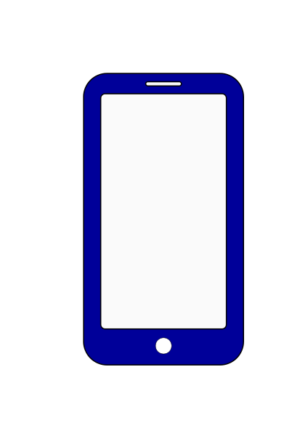
Technology
Notes:
We must also consider what technology the users favor. This is the lens through which they view our software, and it changes the user experience. We can design personas that represent all the combinations of hardware and software that we support. Does this user favor a PC, smartphone, tablet? What is that, Windows, Mac, iOS, Android? What version? Are they using a web browser? Chrome, Firefox, Safari… Internet Explorer or Edge? This is where our personas most affect our test case execution, because we can execute the same tests with various personas. I have some examples designed specifically for that purpose.

Slide 22
The Personas

Slide 23
Hope
Lives in Honolulu, HI
Hawaii-Aleutian Time Zone
Uses a Google Pixel 3
Latest version of Android
2g connection
Notes:
Hope lives in Honolulu, Hawaii. I chose this name because the ‘H’ sound reminds me of Honolulu. Before designing this persona, I didn’t know that a Hawaiian time zone existed. She uses a Google Pixel 3 and keeps the operating system up-to-date – she’s currently on Android 10. This might be an unfair assumption, because Honolulu is a major city, but I decided that she has a poor internet connection

Slide 24
Lee
Lives in Los Angeles, CA
Pacific Time Zone
Uses an iPhone-XS Max
Previous version of iOS
4g connection
Uses Facebook, Instagram
Notes:
Lee lives in Los Angeles, CA – Pacific Time Zone. He uses an iPhone-XS Max, and he doesn’t update the operating system immediately - he’s currently using iOS 12. He has a good network connection, but there’s a wrinkle – he’s using other apps that could compete for bandwidth and hardware resources.

Slide 25
Cass
Lives in Chicago, IL
Central Time Zone
Uses a Samsung Galaxy Note 9
Previous version of Android
4g connection
Uses Uber, Pokemon GO
Notes:
Cass lives in Chicago, IL – Central Time Zone. She’s another Android user, this time a Samsung device, currently running Android 9. She has a good connection, but she’s using other apps which also use her GPS location.

Slide 26
Test Data Library

Slide 27
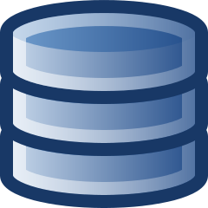
Where can I find a user?
>
Notes:
“Where can I find a user who meets a specific condition?” There are plenty of valid solutions, like SharePoint, wikis, and network drives - but there are some solutions I advise against. We should avoid using the application database – in our test environments, it is not a library, but a landfill. There is too much to parse, too many duplicates, too much invalid data – we can only find helpful data if we are very good at finding it. People find data in the app database, not test data. Do not consider your app database to be a source of test data.

Slide 28
Clean It Up
Remove irrelevant data
Remove duplicate data
Remove bad data
Notes:
No duplicate stories. This is not a public library, but a curated, personal library, where every story is here for a reason, and therefore necessarily unique.

Slide 29
Named Test Data
Notes:
Always associate a name with your test data. When we reference test data in our test automation, it helps to have a descriptive reference. The same kind of description should be added to test data stored in spreadsheets or other forms of documentation. This allows us to replace users without changing the way that they are represented in our tests.

Slide 30
Naming Conventions
Apply conventions to usernames and email addresses
Test Environment
Account Types
Geographical Location
Transaction History
Notes:
Apply conventions any visible and non-critical information included in your data set and imbue your data with meaning.

Slide 31
Fungible Test Data
Test data should be manipulated with ease
Create, change, and delete it as needed
A user can be replaced
but not the archetype
Notes:
Software infrastructure follows a principle that I believe applies to test data design - pets vs. cattle. Are we investing too much effort maintaining our data? In my experience – absolutely. Test data should be fungible. However, we can separate the implementation from the design – replace the user but preserve the archetype.

Slide 32
Summary
Test data should be recognizable and memorable
Test data should be realistic and relatable
Test data should be curated and readily available
Notes:
A summary of three points: tell a story, tell a good story, curate your test data library.

Slide 33
Thank You!
LinkedIn: Joshua Russell
Twitter: @russelljoshuaa
GitHub: github.com/russelljoshuaa
Multiple illustrations by @natelovett

Slide 34
Epilogue

Slide 35
Resources
The Inmates Are Running The Asylum, Alan Cooper
The Anatomy of Story, John Truby

Slide 36
Resources
https://towardsdatascience.com/understanding-the-types-of-data-in-a-business-organization-67d7cb9914bd
http://bi-insider.com/posts/types-of-enterprise-data-transactional-analytical-master/
https://en.wikipedia.org/wiki/Persona_(user_experience)

Slide 37
More Test Data Puns
Noah Count
This user never created an account, but checks out as a guest sometimes
Notes:
More fun test data puns to break up the monotony and serve as examples?

