Slide 1
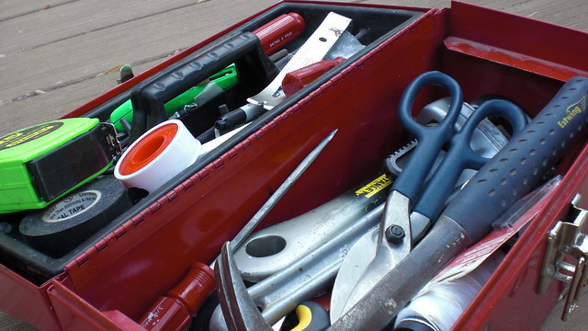
High Impact Techniques for Product Owners
Presented by
Emily Midgley, CBAP, CPOA
This Photo by Unknown Author is licensed under CC BY-SA-NC

Slide 2
About Emily
2005: First work as a Business Analyst
2012: Expanded Horizons
First “Agile” project, CBAP certified
2014: Moved to Enterprise Delivery Practices COE
BA Practice Lead, Agile Coach
Cleveland Chapter of IIBA:
2017 VP of Education & Certification
2019 President
Continually promote small batches of work, fast feedback loops, customer value
@EmFromCleveland on Twitter
Notes:
Progressive has 37,000 people, surpassed $30B in revenue in 2018.
Started as a developer & was quickly frustrated by lack of clarity on what we were being asked to do & why.
I’ve worked at Progressive for my whole career, but in 2012 I started looking externally. Since 2014 it’s been my JOB to look externally and bring in the best stuff.

Slide 3
Agenda
Strategy
Impact mapping
Product Roadmap
Prioritization
Value Stream Mapping
Games – for example, 35
Slicing / Splitting
User Story Mapping
Story Decomposition
Minimum Viable Product
Elaboration / Refinement
Behavior Driven Development
User Stories
Job Stories
Notes:
With 10 techniques in less than an hour, we’re not going in depth with any of them.
Giving you resources for more info with each.
What, when, why, watch out, and resources.

Slide 4
Scrum Team Roles
Development Team
Scrum Master
Product Owner
BAs may be here, as a Development Team member who is skilled in business analysis.
“The Product Owner is responsible for managing the Product Backlog…. The Product Owner may do the above work, or have the Development Team do it. However, the Product Owner remains accountable.”
- Scrum Guide
ScrumGuides.org by Jeff Sutherland and Ken Schwaber is licensed under CC BY-SA
Notes:
Scrum guide says there are 3 roles.
“The job title Business Analyst is going away.” – Bob Prentiss

Slide 5
Strategy
Impact Mapping
Product Roadmap
Notes:
MANY MORE, in fact some more common ones are in the SPLITTING section.

Slide 6
What
Map that contains a single goal, actors who can influence the goals, actions the actors can take, activities that help actors achieve the goals
When
Early & often, when determining strategy, when identifying solution options
Why
Transparency to align stakeholders with organizational goals & the creation of customer value
Watch out
Keep it alive and easy to find
Makes solution implementation quantifiable
Keep it a visual map
Impact Mapping
International Institute of Business Analysis. (2017). Agile Extension to the BABOK ® Guide (2nd ed.) Toronto, ON, CAN: International Institute of Business Analysis
Notes:
Delivering business goals, not just being a feature factory

Slide 7
Impact Map
Goal
Actor
Behavior
Deliverable
Why?
Who?
How?
What?
Behavior
Deliverable
Deliverable
Actor
Behavior
Deliverable
Deliverable
Choose one metric that matters – the problem being solved, not the solution
Person whose behavior you want to change
Frame the behavior of the actors in terms of the business goal
Possible choices that will change behavior
Notes:
Face to face brainstorming, use sticky notes
OMTM (One Metric That Matters) should be SMART (Specific Measurable Action-oriented, Realistic, Timely)
Actor – stakeholder. Making something easier or harder for someone.
Impacts – answers questions (how do we want their behavior to change? How can actors help us achieve our goal? What could actors do to prevent us from achieving our goal?)
Means many possible options, can prevent from solutioning too early.
Can help compare, contrast & prioritize deliverables and mitigate risks.
Try for “MOST LIKELY” first

Slide 8
Impact Map example
Increase customer retention by 20% in 1 year
Customers
Visit site 2x more often
Targeted marketing campaign
Why?
Who?
How?
What?
Find information on site
Improved context-sensitive hep
Community help forum
Customer Service Representatives
Save Subscriptions
Training for CSRs
Increased number of CSRs
Notes:
Revisit often! Implementing one deliverable may change the landscape & impact the others

Slide 9
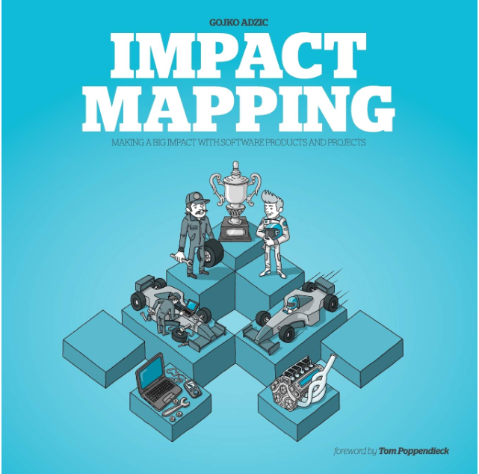
Learn More about Impact Mapping
Impact Mapping: Making a Big Impact with Software Products and Projects, by Gojko Adzic
More info at impactmapping.org

Slide 10
What
When
Create early, revisit often
Why
Communication tool to align stakeholders on terminology & expectations
Watch out
Not a commitment – meant to show sequence
Communicate direction & progress toward the vision for a solution or initiative, and measures progress against that vision through achieving the stakeholders’ desired outcome
Not a list of features – should be about meeting customer needs
Product Roadmap
International Institute of Business Analysis. (2017). Agile Extension to the BABOK ® Guide (2nd ed.) Toronto, ON, CAN: International Institute of Business Analysis
Notes:
Looking at a Product Roadmap should tell us where the product is going. Roadmaps are powerful tools to clearly communicate with stakeholders, and can align terminology and expectations.

Slide 11
Product Roadmap
Sequence of capabilities that flow from the company vision, and reflect the product vision.
Time frame can be broken into quarters, or described as near-term, mid-term, long-term, and released.
Who has input can include product managers, key stakeholders, and technical stakeholders to weigh in on feasibility.
Aspirational, not a commitment like you would see in a Release Plan.
Include disclaimers like "Updated <MM/YY>, subject to change without notice."
Other elements can include target metrics, target customers, confidence level, scalability expectations, and others deemed relevant by the product manager.

Slide 12
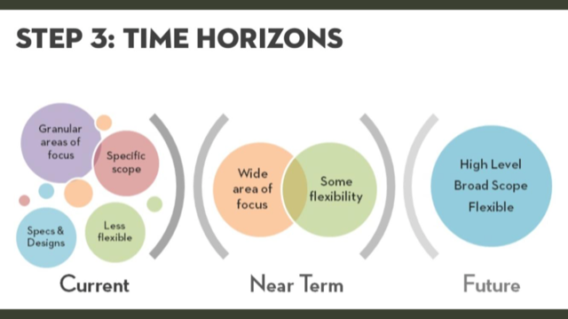
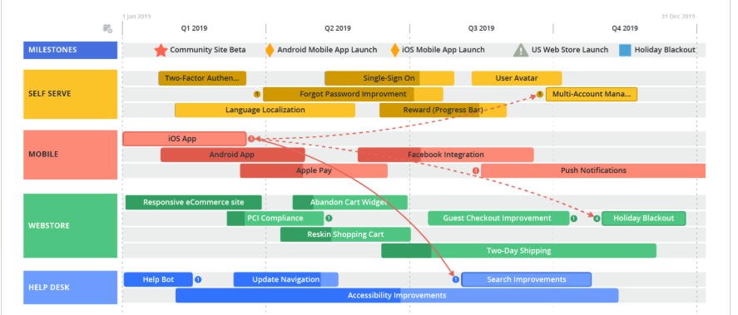
Product Roadmap Examples
Characteristics in various time horizons
From Roadmunk’s site

Slide 13
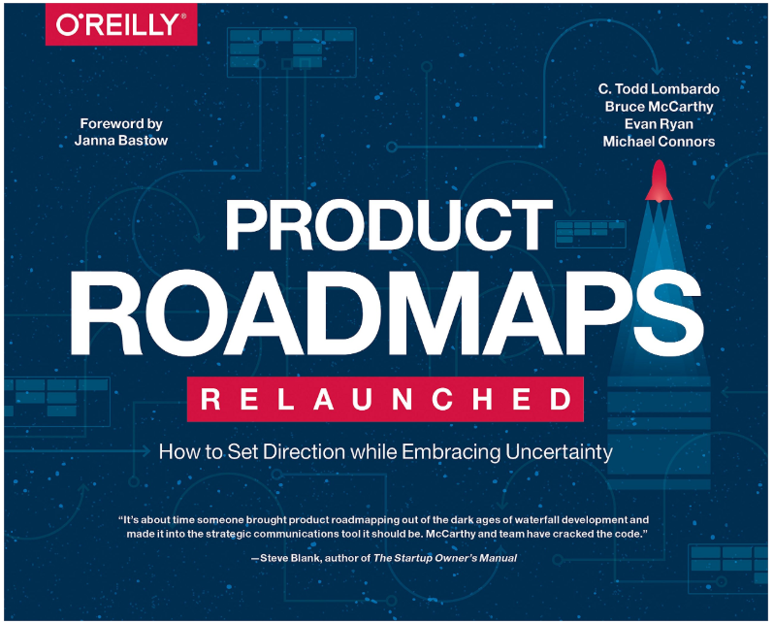
Learn More about Product Roadmaps
Product Roadmaps Relaunched: How to Set Direction while Embracing Uncertainty, by C. Todd Lombardo
C. Todd Lombardo’s talk
https://www.mindtheproduct.com/roadmaps-are-dead-long-live-roadmaps-by-c-todd-lombardo/
Melissa Perri’s blog Effective Product Roadmaps
https://melissaperri.com/blog/2017/02/15/product-roadmaps
Roman Pichler’s article
https://www.romanpichler.com/blog/product-roadmap-product-backlog/

Slide 14
Prioritization
Value Stream Mapping
Collaborative Games

Slide 15
What
Representation of the stream of activities required to deliver a product or service to an internal or external customer
When
Determining which part of the process to improve
Why
Shared understanding of process waste & bottlenecks
Watch out
This is a process improvement technique - not external customer journeys
Don’t make it perfect – good enough to see where to make the next improvement
Blueprint for implementing improvement
Value Stream Mapping
for process improvement
International Institute of Business Analysis. (2017). Agile Extension to the BABOK ® Guide (2nd ed.) Toronto, ON, CAN: International Institute of Business Analysis
Notes:
Value Stream Mapping is a concept from Lean Manufacturing

Slide 16
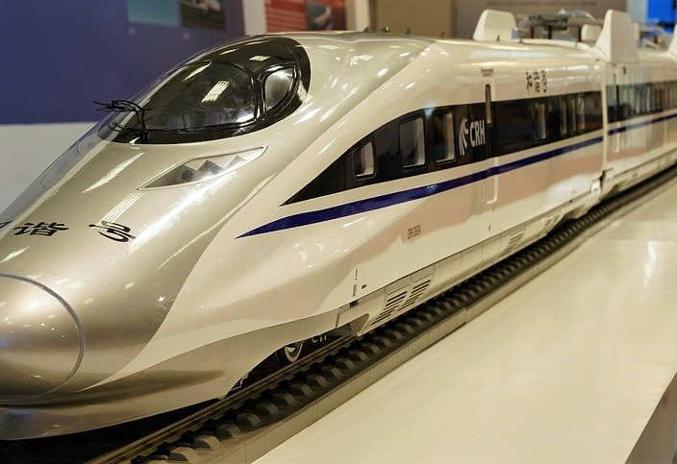
Value Stream Mapping tips
Can create two – current state, future state
Tread lightly – discussing “waste” can bring defensiveness
Start with sticky notes & paper
Understand that it won’t be done immediately
Identify cycle time and wait time
Theory of Constraints: the biggest bottleneck is the place to start
Start where you are to see where to improve
Don’t be afraid to show current process & wait times
Notes:
Likely a lot of stakeholders – may need multiple sessions
Tread lightly - Questioning today’s world and identifying “waste” can bring defensiveness, fear, uncertainty
Start with paper, then transfer to electronic format
Don’t add waste by Over-processing in Visio

Slide 17
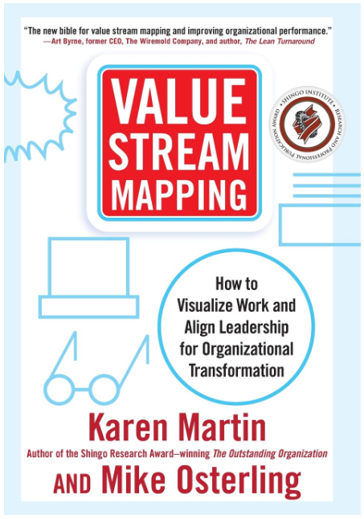
Learn More about Process Improvement
Value Stream Mapping: How to Visualize Work and Align Leadership for Organizational Transformation by Karen Martin and Mike Osterling
The Goal: A Process of Ongoing Improvement by Eliyahu Goldratt
For more on the Theory of Constraints
Making Work Visible: Exposing Time Theft to Optimize Work & Flow by Dominica DeGrandis

Slide 18
What
Games to encourage participants to collaborate in building a joint understanding of a problem or solution
When
Prioritization, elicitation, when you need buy-in from people, or when things feel stale
Why
Gain shared understanding
Watch out
Not a good fit for some personalities & cultures
Can be perceived as unproductive – be clear about objectives & outcomes
Encourage creative thinking
Can show hidden assumptions
Collaborative
Games
International Institute of Business Analysis. (2015). A Guide to the Business Analysis Body of Knowledge ® (3rd ed.) Toronto, ON, CAN: International Institute of Business Analysis
Notes:
Collaborative Games themselves are a technique in BABOK V3. That centers on elicitation. But there’s a specific game called “35” that helps with prioritization

Slide 19
Game: 35 for Collaborative Prioritization
Give each person in the room a user story on an index card. Make sure people understand their user stories.
Pair up, each person describes their user story, the pair decides how to rank them in priority on a scale of 1 to 5. Write the number on the back of the card. Timebox to 1 minute.
Trade stories.
Find a new pair.
Do that 7 times total. (Highest possible priority score is 35, hence the name.)
Add the scores on the back of each story, rank all user stories on the wall (put 30s up high, 25s a little lower, etc.)
People buy in because they have a chance to discuss & contribute, and no single voice overrules the others. Use this for dozens of people & user stories.

Slide 20
Learn More
Innovation Games: Creating Breakthrough Products Through Collaborative Play by Luke Hohmann
Innovationgames.com

Slide 21
Splitting
User Story Mapping
Minimum Viable Product
Vertical Slicing
Notes:
These also help with PRIORITIZATION

Slide 22
What
When
Create when beginning to implement a solution
Why
Helps maintain customer focus
Watch out
Doesn’t naturally show dependencies
Assists in creating understanding of product functionality, the flow of usage, and to assist with prioritizing product delivery
Best for process-oriented contexts
Provide larger context to avoid getting lost in details
Revisit to keep the “why” in mind
(User) Story Mapping
International Institute of Business Analysis. (2017). Agile Extension to the BABOK ® Guide (2nd ed.) Toronto, ON, CAN: International Institute of Business Analysis
Notes:
IIBA calls this “Story Mapping”. Others call it “User Story Mapping” and I prefer that so we keep focus on the user and WHY we’re even thinking about this work.
Also helps organize & prioritize the work
In this section because it helps break down the work into deliverable, useful pieces
Other benefits I’ve seen personally: can output to a workflow tool like TFS or Jira.

Slide 23
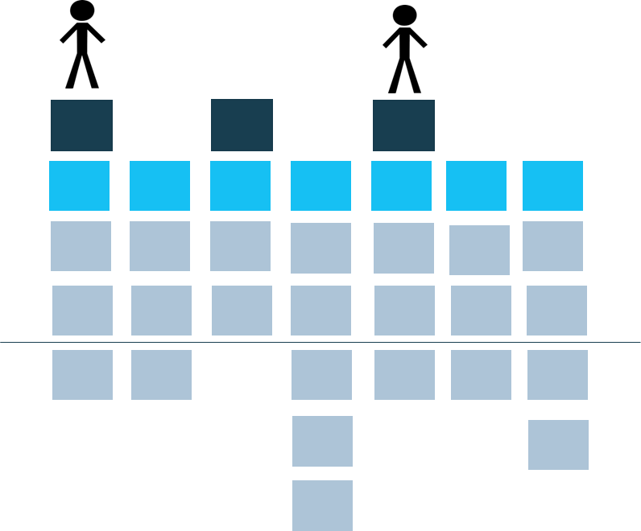
User Story Mapping Overview
What is it?
User Story Mapping is an approach to organizing and prioritizing user stories. A user story map arranges user stories into a useful model to help understand user needs, identify holes and omissions, and effectively plan holistic releases that deliver value to users and business with each release.
1. Frame the Problem
Who is it for, and why are we building it?
2. Map the Big Picture
Map out the whole story at a high-level to create the backbone. Focus on breadth, not depth.
3. Explore
Fill out the body of the map by breaking down larger tasks into subtasks and details.
4. Slice Out Viable Releases
Slice the map into holistic product releases.
Use Verb Noun
“Manage Email”
5. Slice Out a Delivery Strategy
Slice the first release of your map into three or more delivery phases. This delivery strategy will help you release the best product possible in the time constraints you have.
Patton, Jeff. User Story Mapping O’Reilly Media, 2014. Print.
Notes:
Jeff Patton popularized the method of user story mapping in his book “User Story Mapping”
Patton recommends this five step process

Slide 24
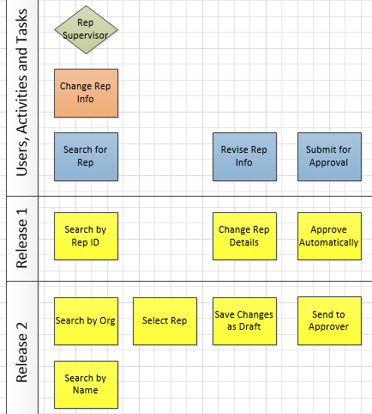
User Story Mapping Example
Supervisor Changes Rep info

Slide 25
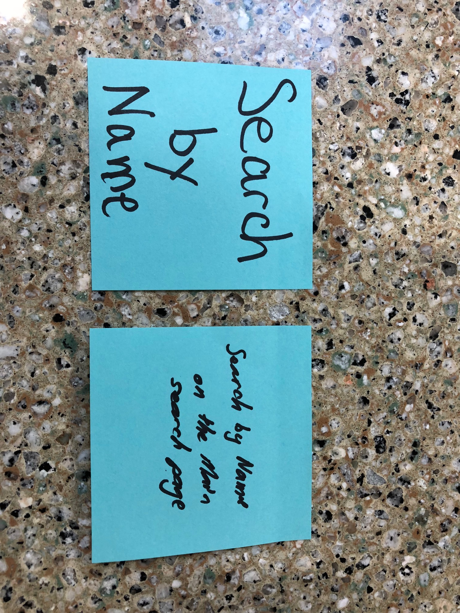
User Story Mapping - Sticky Notes
Verb Noun
2-4 Words
BIG LETTERS

Slide 26
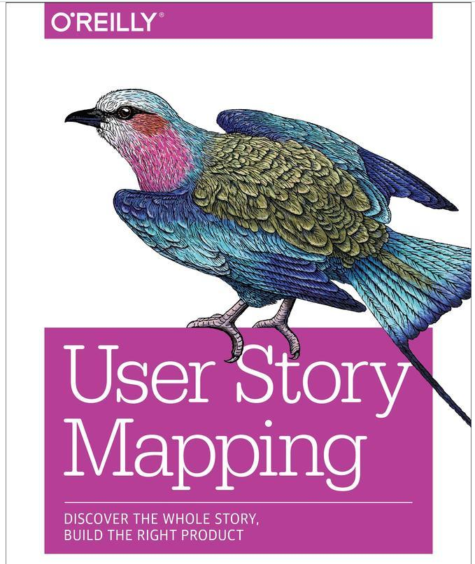
Learn More
User Story Mapping: Discover the Whole Story, Build the Right Product by Jeff Patton

Slide 27
What
When
Developing a product, service, feature, and as differentiation
Why
Reduce risk: Collect and analyze feedback when there is uncertain demand, and before investing additional resources
Watch out
Don’t use MVP as an excuse for low quality or effort
Helps avoid cost and risk associated with developing the wrong product by testing a hypothesis, reducing waste, or increasing speed to customers for feedback and adoption
Not useful for a clear or simple solution
To provide something to a customer when there are time or money constraints
Unsure of consumer response to a proposed solution
Mindsets
Minimum Viable Product
International Institute of Business Analysis. (2017). Agile Extension to the BABOK ® Guide (2nd ed.) Toronto, ON, CAN: International Institute of Business Analysis
Notes:
Just enough
Deploy business value sooner
Gather validated learning

Slide 28
MVP – Mindsets to Watch
Dictating a solution – uninterested in pitches for a smaller product test
Lack of trust – Don’t believe that the team will come back to the next increment

Slide 29
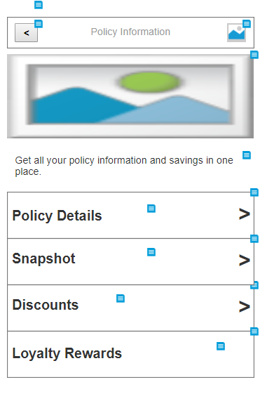
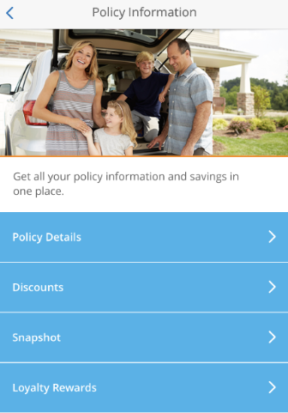
MVP – Misconceptions
Incrementally Releasing
100% of Planned Scope
Relaxing the Standards
Notes:
Producing MVPs is not releasing things that aren’t up to your company’s standards. And don’t release something that’s halfway done, for example assuming someone will pay off technical debt later.
Minimum doesn’t mean the absolute least you can do. Minimum means just enough, while still acceptable.
MVPs are also not delivering 100% of planned scope, spread over multiple releases or phases. Incremental delivery is still good because you’re getting value sooner.
In this case, the team isn’t adjusting what they’re doing based on validated learning, and this also isn’t MVP.

Slide 30
Minimum Viable Product MVP Cycle
Build Small Batches
Gather Validated Learning
Inform Continued Refinement
Notes:
Teams use an MVP approach when they: Build in small batches, gather feedback about how the product or feature is received, and then use that data to inform continued refinement.

Slide 31
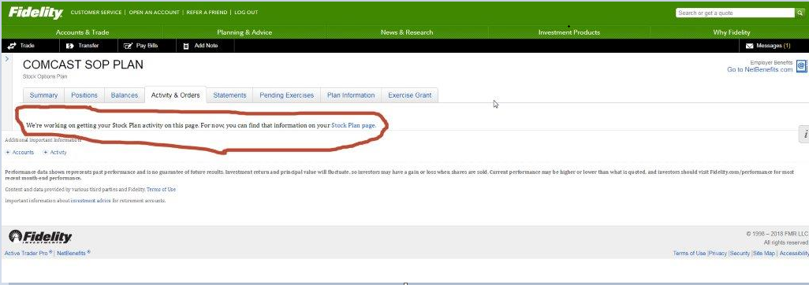
Classic MVP example
Measure: How often do people land on this page?
Notes:
Classic example of an MVP

Slide 32
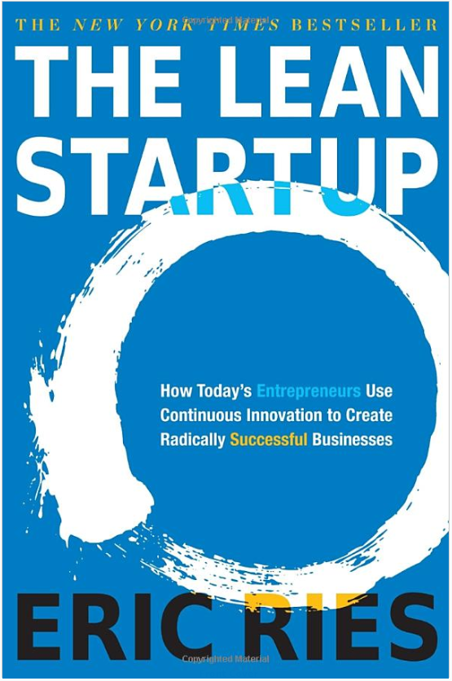
Learn More about MVP
The Lean Startup: How Today’s Entrepreneurs Use Continuous Innovation to Create Radically Successful Businesses by Eric Ries
The Lean Product Playbook: How to Innovate with Minimum Viable Products and Rapid Customer Feedback, by Dan Olsen

Slide 33
What
When
Until the team can deliver a story in less than a sprint
Why
Watch out
Write just enough & just in time so that you don’t revert to detailed requirements up front
Represent the requirements of a solution at the appropriate level of detail and aligned to desired outcomes
Keep big-picture context & goals, release-level planning
Assist with release-level planning
Don’t create instructions to the team
Story Decomposition
International Institute of Business Analysis. (2017). Agile Extension to the BABOK ® Guide (2nd ed.) Toronto, ON, CAN: International Institute of Business Analysis
Notes:
Examples of instructions to the team: build database, build servers, build APIs, Design, build, test
This can be the hardest habit to break, so let’s talk about Vertical Slicing

Slide 34
Story Decomposition with Vertical Slicing
“Vertical” refers to the technology stack
A vertical slice doesn’t have to change each technology in the stack
One person doesn’t have to implement a vertical slice on their own
Horizontal Slices
Vertical Slices
User Interface
APIs
Services
APIs
Database
User Interface
APIs
Services
APIs
Database
MVP V2 V3 V4 Exclude
{
{
{
{
Learn
Learn
Learn
Learn
Big Bang Release
Notes:
Small, thin piece of functionality that goes up & down the technology stack.
Objective is NOT to hit every layer.
Objective is to provide value to a customer. Often that means that changes are needed in multiple layers.

Slide 35
Story Decomposition with Vertical Slicing
What’s a Vertical Slice?
A deliverable that provides value to some customer, independent of technology.
Very similar to MVP, but the feedback could come from an internal customer.
Benefits
Early integration → less risk (release testing, complex code merges)
Builds confidence
Improves predictability
Reduced lead time to value
Techie Mindset
Deeply ingrained habit to think about technical tasks
Perception of refactoring being bad
Skill sets needed: application layers are deep, and often come with lots of dependencies
Need a full stack team, not necessarily full stack developers

Slide 36
Vertical Slicing Methods
SLICER
Spike
Line
Interface
CRUD
End User
Rules
Notes:
These examples overlap. Meant to get the team thinking.

Slide 37
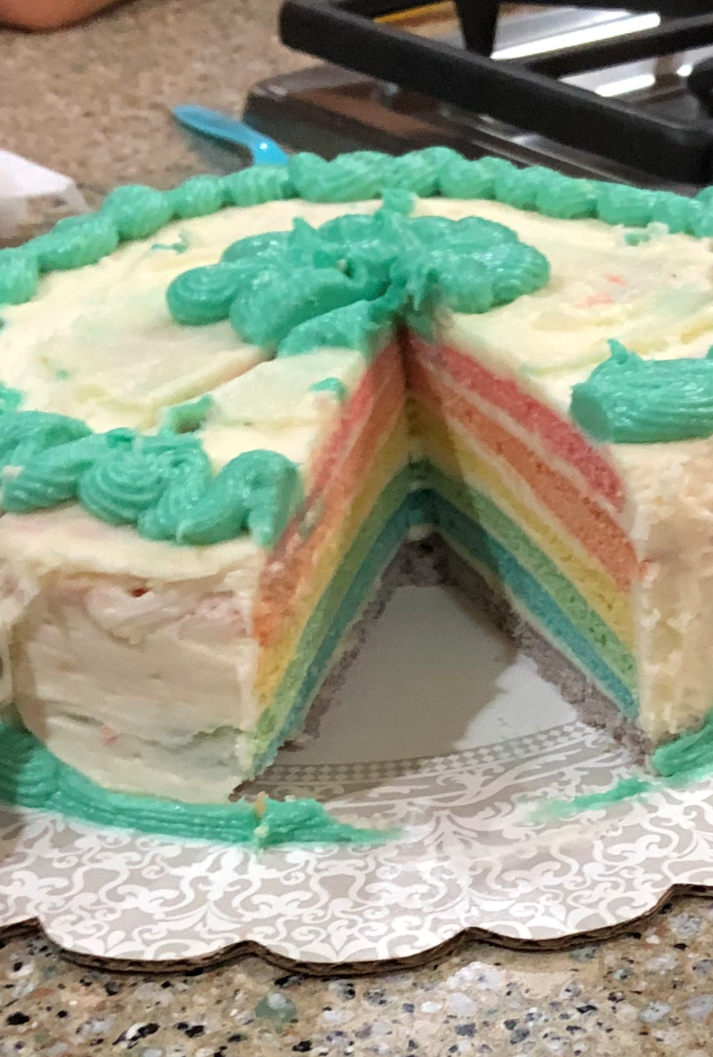
Learn More about Story Splitting
Mike Cohn’s Video Training for how to Split User Stories
https://www.mountaingoatsoftware.com/blog/video-training-how-to-split-user-stories
Several other resources on Mountain Goat Software
“Split” in Agile Alliance glossary, and several articles for further reading
https://www.agilealliance.org/glossary/split/

Slide 38
Refinement
Behavior Driven Development
User Stories
Job Stories

Slide 39
What
When
Figuring out conditions of acceptance for user stories
Why
Watch out
Collaborative approach to identifying intended customer behavior using real examples in a customer readable, domain specific language
Develop only what is needed
Requirements & tests are built together with no translation required
Can automate the tests with Cucumber tools for speed gains
Keep the examples UI & technically agnostic for maximum reuse potential
Keep the examples simple & focused, with one action
Behavior-Driven Development
International Institute of Business Analysis. (2017). Agile Extension to the BABOK ® Guide (2nd ed.) Toronto, ON, CAN: International Institute of Business Analysis

Slide 40
More Benefits to Collaborating with BDD
Shared Understanding
For the current team, so they know what to do next
For those who support the product
Business Outcomes
Let the next team improve the solution
Reuse
When we change this application
For each layer of the system
Let the team find the right solution
When another application picks up this change
Notes:
This is what I’ve seen, working with teams who have actually automated Gherkin statements as acceptance tests.

Slide 41
What is Gherkin?
A business readable, domain specific language created specifically for behavior descriptions.
Understood by a tool called Cucumber.
Given <an initial context>
When <something happens>
Then <observable outcome(s)>

Slide 42
Learn More about BDD
Specification by Example: How successful teams deliver the right software, by Gojko Adzic
Fifty Quick Ideas to Improve Your Tests, by Gojko Adzic
BDD in Action: Behavior-Driven Development for the whole software lifecycle, by John Ferguson Smart
Written for software developers

Slide 43
What
When
Describing value to deliver, at any level of detail
Why
Watch out
Representation of customer need expressed as a small, concise statement of a feature needed to deliver value
Keeps focus on customer value
Deceptively simple → need diligence about value discussion
As a <user>, I need <feature>, so that <value>.
Simple to learn
Invites conversation
User must truly be a user (not developer, data architect, etc.)
Must usually supplement with other analysis models
User Stories
International Institute of Business Analysis. (2017). Agile Extension to the BABOK ® Guide (2nd ed.) Toronto, ON, CAN: International Institute of Business Analysis
Notes:
A well-written user story that’s about business need will help the team come up with different potential solutions.
Start with why, that will lead you to who and what.
No really, who is the customer? BE SPECIFIC. Not just a mobile user, but one with a limited data plan – that’s how we know what they care about.

Slide 44
User Stories should describe Actual Users
Ask “Why”
As a Technical Architect
I want a new database table
So that we store which UserIDs are permitted to make Digital Payments
As a Claims Supervisor
I want to access payment permissions
So that I know which reps on my team are authorized to make make Digital Payments
As a Product Owner
I want a payment permission indicator
So that we can allow some Claims Reps to make Digital Payments
As an injured claimant
I want a digital payment
So that I can pay my medical bills on time
Notes:
This shows how we often write user stories – from the perspective of the Tech Lead or the Product Owner.
As we keep asking “why”, we get closer to an actual user (Claims Supervisor) and then the beneficiary of the work (injured claimant).

Slide 45
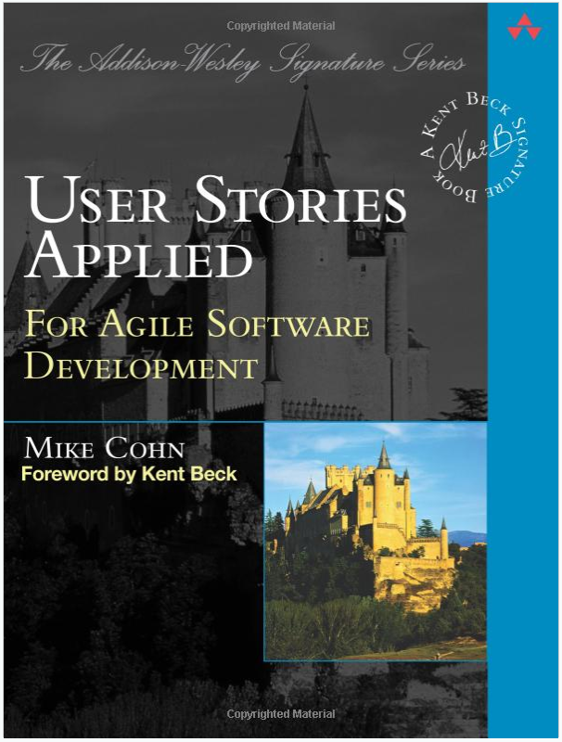
Learn More
User Stories Applied: For Agile Software Development, by Mike Cohn
Fifty Quick Ideas to Improve Your User Stories, by Gojko Adzic
User Story Mapping: Discover the Whole Story, Build the Right Product by Jeff Patton

Slide 46
What
When
Describing value to deliver, at any level of detail
Why
Watch out
Represents a backlog item or requirement in terms of jobs to be done.
Focus on motivation (anxieties & struggles) & customer need
Can get verbose, can feel too easy
Can pair with user stories: Job story – motivation & outcome. User story – feature to address the problem.
Can leave teams frustrated because they still need to figure out implementation
Job Stories
International Institute of Business Analysis. (2017). Agile Extension to the BABOK ® Guide (2nd ed.) Toronto, ON, CAN: International Institute of Business Analysis

Slide 47
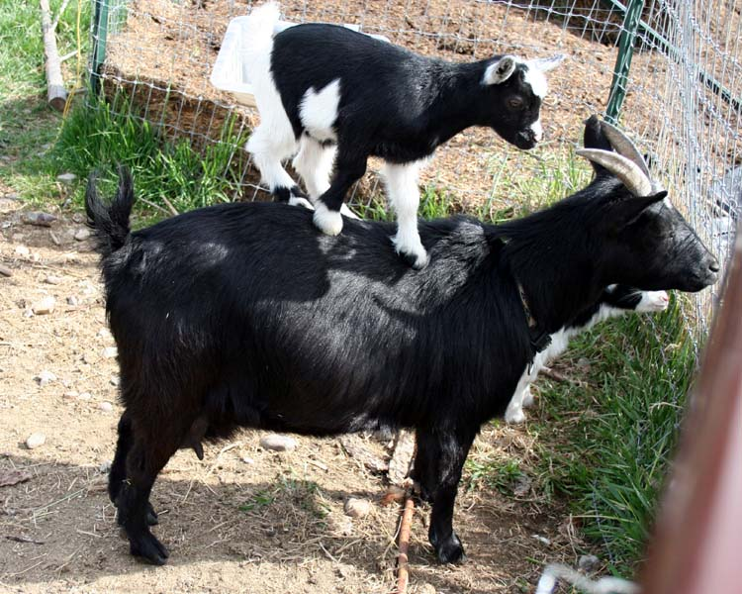
Jobs To Be Done theory
Customers are hiring your products to get their jobs done.
“The customer rarely buys what the company thinks it is selling them.” - Peter Drucker
Describing features confuses the customer because they don’t know how the features help them.
Job to be Done | Product
Music anywhere; “create a mood” | Walkman, Discman, iPod, Zune, phone
Get somewhere | Atlas, GPS
Arterial blood flow | Stent
Hole in the wall | Drill
Trimmed lawn | Lawnmower, grass seed, sprinklers, landscaping service, goat

Slide 48
Job Stories
Interview and observe
Formats:
When <situation> I want to <motivation> so I can <expected outcomes>
When <someone <situation>, actor(s) <motivation> so that <expected outcomes>
Examples:
When I want to withdraw money from my bank account, I want to know I have enough money to withdraw some now so I can go out to dinner with my friends.
When someone wishes to withdraw money from their bank account, the customer wants to know if funds are available, the teller wants to know if the person banks with us, so that the person requesting can receive the desired cash amount
International Institute of Business Analysis. (2017). Agile Extension to the BABOK ® Guide (2nd ed.) Toronto, ON, CAN: International Institute of Business Analysis

Slide 49
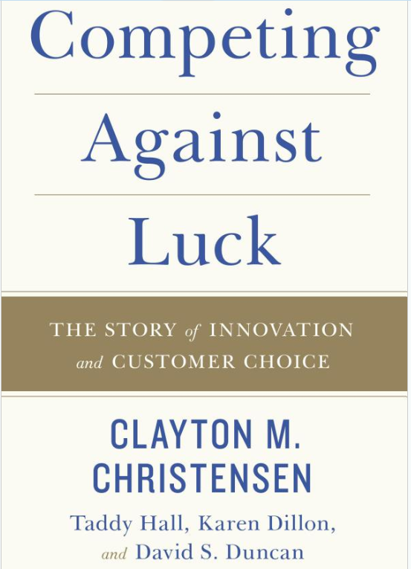
Learn More
Competing Against Luck: The Story of Innovation and Customer Choice, by Clayton M. Christensen, Taddy Hall, Karen Dillon, and David S. Duncan
Blog from Mike Cohn
https://www.mountaingoatsoftware.com/blog/job-stories-offer-a-viable-alternative-to-user-stories
Mastering Business Analysis podcast, by Dave Saboe
Episode 120 with Alan Klement: https://masteringbusinessanalysis.com/mba120-jobs-done-theory/
Episode 184 with Brian Rhea: https://masteringbusinessanalysis.com/mba184-discover-what-customers-want-with-jtbd/

Slide 50
Some PO Techniques
Backlog Refinement
Planning Workshop
Story Mapping
MVP
Story Mapping
Story Decomposition
Provide Value to Customer
Provide Shared Understanding
Make Decisions
Provide Feedback
Align to Product Vision
Slice into small batches
Prioritize
Elaborate
Answer Questions
Evaluate Solution
Discover Needs
Product Roadmap
Visioning
Business Model Canvas
Retrospectives
Reviews
Personas
Value Modeling
General elicitation
Planning Workshop
Story Mapping
Acceptance Criteria
Impact Mapping
Metrics & KPIs
Story Elaboration
Job Stories
User Stories
Acceptance Criteria
Behavior Driven Development
General collaboration
Notes:
The “HOW”
Vast majority of these techniques are in the BABOK or Agile Extension

Slide 51
Keep Learning & Growing!

