Slide 1
Business Analysis for Leaders
Presented by John Hrivnak, Senior Manager at Sogeti
John.Hrivnak@us.sogeti.com

Slide 2

Agenda
Introduction
What is Business Analysis?
The Challenge: Promoting Business Analysis Value
Coaching the Business Analysis Team
4. Wrap Up

Slide 3

Introduction
Leadership awareness of and trust in their business analysis capabilities is the most important factor in expanding the role and reach of the discipline. The research, however, suggests misalignment between practitioners and leaders on what business analysis skill sets really are and where they reside.
*Business Analysis – Positioning for success; Copyright 2016 KPMG/IIBA

Slide 4
Introduction
The challenge facing the community is therefore two-fold: (i) expand and elevate skill sets to tackle increasingly complex business problems; and, (ii) ensure leadership understands and leverages their full capabilities today. Getting practitioners more comfortable promoting themselves and discussing successful outcomes directly with leadership will help with this effort.
*Business Analysis – Positioning for success; Copyright 2016 KPMG/IIBA

Slide 5
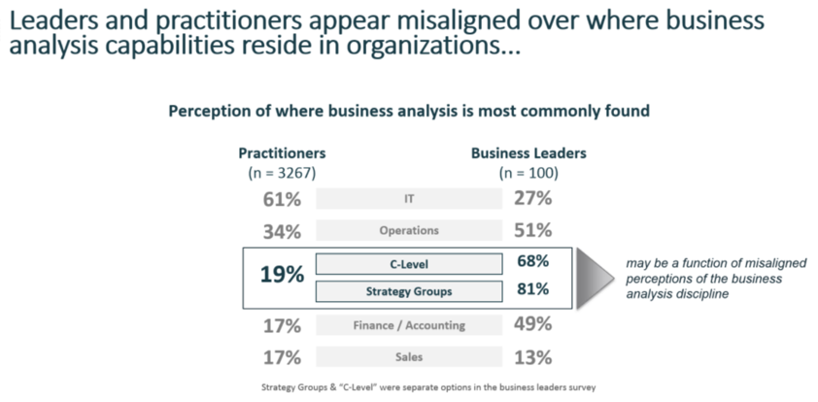
Introduction
*Business Analysis – Positioning for success; Copyright 2016 KPMG/IIBA

Slide 6

What is Business Analysis?

Slide 7

Business Analysis Defined
“Business analysis is the practice of enabling change in an enterprise by defining needs and recommending solutions that deliver value to stakeholders.”*
*BABOK® v3.0 IIBA pg2

Slide 8
Business Analysis Capabilities Defined
“Business analysis enables an enterprise
to articulate needs and the rationale for
change, and to design and describe
solutions that can deliver value.” *
*BABOK® v3.0 IIBA pg2

Slide 9
Business Analysis Capabilities: A Closer Look
Business analysis enables an enterprise to:
Articulate needs (elicit/define business and solution
requirements)
Articulate the rationale for change (business case)
Design and describe solutions that can deliver value
(document the details of the solutions needed by the business
that may or may not include technology components)

Slide 10
The Challenge:
Promoting Business Analysis Value

Slide 11

The value of Business Analysis and the Business Analyst
Leadership in the business analysis space is about ensuring every level of your organization recognizes the value business analysis and business analysts bring to the processes of creating better business outcomes and solving business problems.

Slide 12
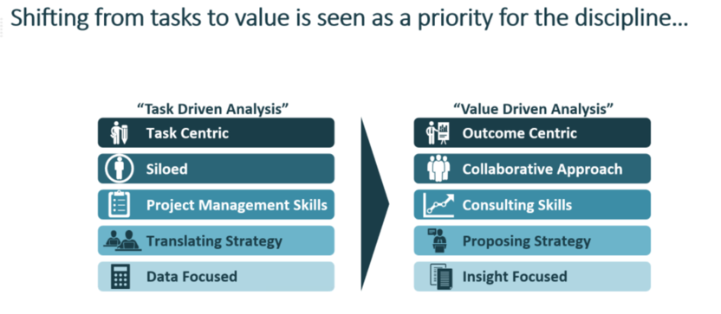
The shifting focus to value…
*Business Analysis – Positioning for success; Copyright 2016 KPMG/IIBA

Slide 13
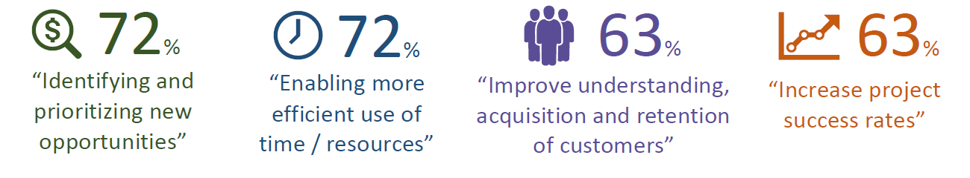
Getting Leadership to “buy in”
Priorities of Business Leaders
*Business Analysis – Positioning for success; Copyright 2016 KPMG/IIBA

Slide 14
The role of the Business Analyst
“Business analysts align the designed and delivered
solutions with the needs of stakeholders. The activities
that business analysts perform include:
  • Understanding enterprise problems and goals
  • Analyzing needs and solution
  • Devising strategies
  • Driving change
  • Facilitating stakeholder collaboration.”*
*BABOK® v3.0 IIBA pg3

Slide 15
Coaching the
Business Analysis Team

Slide 16
Coaching the Business Analysis Team
The business analysis team needs a vision or goal for what the team, no matter the size, is striving to achieve.
After the vision or goal is set, it doesn’t matter what that goal is, every activity must be tied back to how it contributes to the achievement of the goal.

Slide 17
Coaching the Business Analysis Team
The business analysis leader must determine the behaviors that are required for the vision or goal to be achieved.
One of the key aspects of those behaviors is the ability to execute at a high standard even during adversity.
The focus here is to build a team that has the skills, discipline, and desire to perform consistently at a high level.

Slide 18
Coaching the Business Analysis Team
Now comes the hard work; Leaders must make sure the right people are on the bus and they get the other people off the bus.
Leaders must also work to create an environment of continuous improvement; there will be adversity and the process won’t always work. That is why the practice of inspect and adapt are critical.

Slide 19
Coaching the Business Analysis Team
Why?
Because success in achieving the goal is not a continuum. One successful project doesn’t mean the next one will end the same.

Slide 20
Coaching the Business Analysis Team
Leading a successful business analysis team is about inspecting and adapting constantly to uncover and address underlying risks and trends that if left unchecked will derail efforts to perform at a high level and deliver the value business analysis brings to an organization consistently.
Develop your process then trust the process you’ve built.

Slide 21
Wrap Up

Slide 22
Wrapping up
For the organization, Business Analysis Leaders communicate the value of business analysis is about:
Enabling change.
Executing behaviors that articulate business needs.
Executing behaviors that articulate the reason (value) for change.
Executing behaviors that design and define solutions and better business outcomes.

Slide 23
Wrapping up
For the Business Analysis Team Leaders:
Define the vision or goal for the team.
Define behaviors needed to achieve the vision or goal.
Assemble resources with the right mindset, skills, and ability to execute at a high level even in the face of adversity.
Trust the process enough to change by inspecting, adapting, and pivoting to help ensure continued success.

Slide 24



About Sogeti
Part of the Capgemini Group, Sogeti operates in more than 100 locations globally. Working closely with clients and partners to take full advantage of the opportunities of technology, Sogeti combines agility and speed of implementation to tailor innovative future-focused solutions in Digital Assurance and Testing, Cloud and Cybersecurity, all fuelled by AI and automation. With its hands-on ‘value in the making’ approach and passion for technology, Sogeti helps organizations implement their digital journeys at speed.
A global leader in consulting, technology services and digital transformation, the Capgemini Group is at the forefront of innovation to address the entire breadth of clients’ opportunities in the evolving world of cloud, digital and platforms. Building on its strong 50-year heritage and deep industry-specific expertise, Capgemini enables organizations to realize their business ambitions through an array of services from strategy to operations. Capgemini is driven by the conviction that the business value of technology comes from and through people. It is a multicultural company of over 200,000 team members in more than 40 countries. The Group reported 2018 global revenues of EUR 13.2 billion. People matter, results count.
Visit us at www.sogeti.com
Thank you for your
time and attention!
John Hrivnak,
Senior Manager, Sogeti
John.Hrivnak@us.sogeti.com
This message contains information that may be privileged or confidential and is the property of the Capgemini Group.
Copyright© 2019 Sogeti. All rights reserved.

