Slide 1
Off the Happy Path
Looking at requirements from a tester’s point of view

Slide 2
Presentation Abstract
Let’s face it, there are more things that you want the application NOT to do then to do. As a tester, it’s my job to figure out how to gain access to all the unmarked paths surrounding the happy path and locate gaps in requirements and not forget those pesky bugs.
As the rest of the team focuses on positive requirements and positive paths through the application, I look at all of the negative requirements and negative paths where the gaps and bugs live. Come explore with me as I share tips on how to create requirements that keep your tester (and users) traveling down the happy path.

Slide 3
Team Member Focus
Project Manager/Product Owner focus is what is in scope.
Business Analysts focus on determining and documenting what the customer wants to achieve based on what is in scope.
Customer focus is to get their job done in the easiest way possible.
Developers focus on creating a solution that bring the requirements to life while staying in the boundaries set by the scope.
Quality Assurance focus on verifying that the requirements are all satisfied and application does not do anything unexpected.

Slide 4
Positive: Something I want to happen.
Picture Source: http://www.crossingitaly.net/travel/wp-content/uploads/Beach-holidays.jpg

Slide 5
Happy Path
Happy path is meant to describe the ideal process, without any exceptions or alternate paths. Architect Solutions The problem with the “Happy Path”
Notes:
Ideal process Positive experience

Slide 6
Positive Requirements
Support the business by being present.
Documented “What” the business needs/wants
Acceptance Criteria
The application SHALL/Must…
Standards
Performance
Security
Regulatory

Slide 7
How to Build a Happy Path
Positive Requirement 1
Positive Requirement 2
Positive Requirement 3
Positive Requirement 4
Positive Requirement 5
Positive Requirement 6

Slide 8
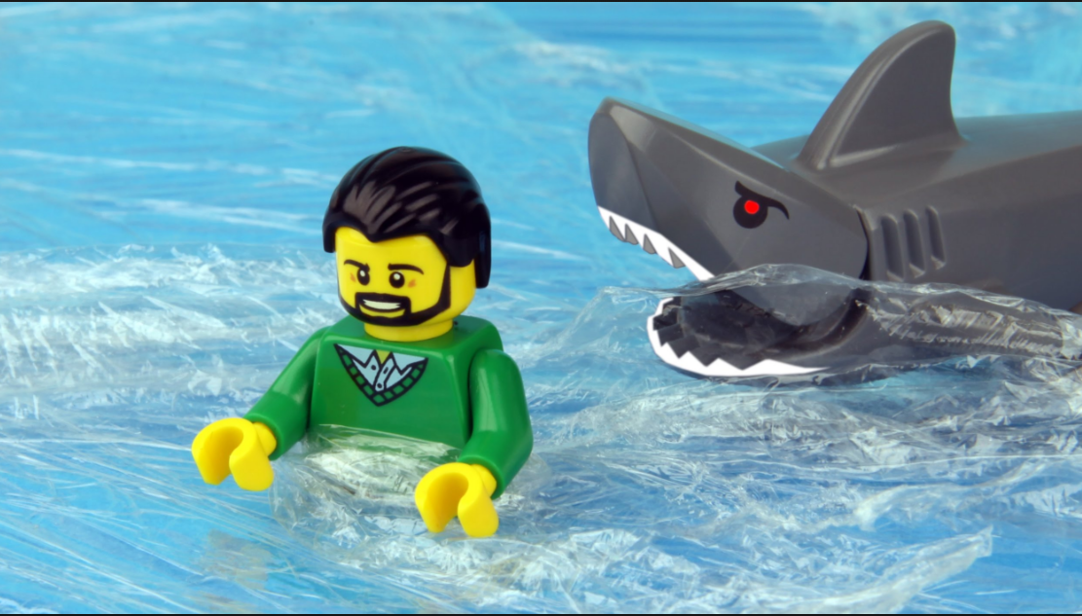
Negative: Something I don’t want to happen
Image Source: https://www.doovi.com/video/lego-shark-attack/lQcOEQXvNKU

Slide 9
Negative Requirements
Supports the business by NOT being present.
Implied “What” the business does not want
Non-Manager will NOT be able to…
The application SHALL NOT/MUST NOT…
Violation of Standards
Application Crashes
Does not limit access to Private Information (PI)

Slide 10
Negative Requirements and the Happy Path
Negative Requirement
Negative Requirement
Negative Requirement
Negative Requirement
Negative Requirement
Negative Requirement
Positive Requirement
Positive Requirement
Positive Requirement
Positive Requirement
Positive Requirement
Positive Requirement
Negative Requirement
Negative Requirement
Negative Requirement
Negative Requirement
Negative Requirement
Negative Requirement

Slide 11
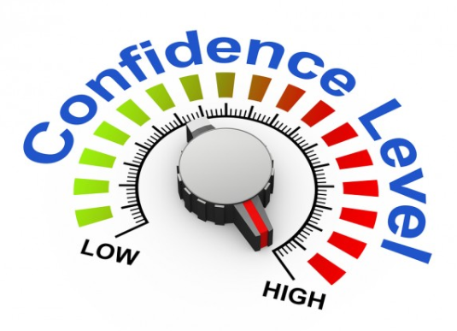
“The principle objective of software testing is to give confidence in the software.” – Anonymous

Slide 12
Positive testing
Verify that the application does what is expected.

Slide 13
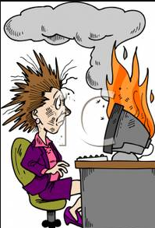
Negative testing
Verify That The Application Doesn’t Do Anything Unexpected.
https://archuletavenue.files.wordpress.com/2011/09/cartoon_woman_at_work_with_her_computer_on_fire_royalty_free_clipart_picture_090604-161121-837042.jpg

Slide 14
Scripted Test
Definition: Tests that are created based on requirements/standards where documentation is completed before testing begins.
Purpose: Test the known
Test positive requirements
Test negative requirements
Execution: Manual or Automated

Slide 15
Scripted Test Example
Positive Requirement:
As a Manager, I want to be able to reassign a work item to the department director I report to, so that it can be escalated.
Positive Scripted Test:
Logged in as a manager, I can reassign a work item to my department director.
Negative Scripted Test:
Logged in as a manager, I can not reassign a work item to a department director that I do not directly report to.
Logged in as a manager, I can not reassign all my work items to my department director.
Logged in as a manager, I can not reassign a work item to a manager.
Logged in as a customer service rep, I can not reassign a work item to my department director.

Slide 16
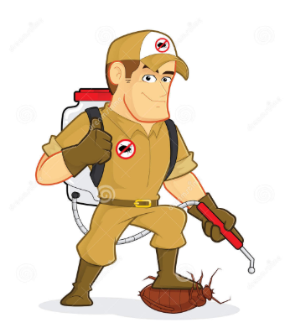
“More than the act of testing, the act of designing tests is one of the best bug preventers known. The thinking that must be done to create a useful test can discover and eliminate bugs before they are coded – indeed, test-design thinking can discover and eliminate bugs at every stage in the creation of software, from conception to specification, to design, coding and the rest.” – Boris Beizer

Slide 17
Exploratory Testing
Definition: Manual testing that systematically explores the application to gain a deeper understanding of the functionality of the application around the boundaries of requirements/standards.
Purpose: Test the “space” between and around the positive and negative requirements/scripted test.
Find less obvious tests that need documented.
Identify missing requirements, creative interpretations of requirements or inconsistencies in functionalities.
Execution: Manual

Slide 18
Adhoc Testing (Bug Hunting)
Definition: Free flowing manual testing that explores the application outside of the boundaries of requirements/standards.
Purpose: Identify fringe cases and bugs that are off the expected user paths.
Execution: Manual

Slide 19
AdHoc Test
Positive
Positive Scripted Test
Positive Scripted Test
Positive Scripted Test
Positive Scripted Test
Positive Scripted Test
Positive Scripted Test
Positive Requirement
Positive Requirement
Positive Requirement
Positive Requirement
Positive Requirement
Positive Requirement
Negative Requirement
Negative Requirement
Negative Requirement
Negative Requirement
Negative Requirement
Negative Requirement
Negative Scripted Test
Negative Scripted Test
Negative Scripted Test
Negative Scripted Test
Negative Scripted Test
Negative Scripted Test
Negative
Negative Scripted Test
Negative Scripted Test
Negative Scripted Test
Negative Scripted Test
Exploratory Test
Negative Scripted Test
Negative Scripted Test
Exploratory Test
Negative Scripted Test
Negative Scripted Test
Exploratory Test
Negative Scripted Test
Negative Scripted Test
Exploratory Test
Exploratory Test
Exploratory Test
Exploratory Test

Slide 20
Marketing Case Study
Marketing wants to send out a targeted marketing letters to all active accounts for State of Confusion 457 plan that have not had a contribution in 6 months or more to encourage people to save more for retirement.
Positive Requirements:
Identify all Great State of Confusion 457 accounts that have not had a contribution in six months or longer that are in Active status.
Generate a mail file that contains: Account Type, Account Status, Name, Address, City, State, Zip, Date of last deposit, Gender

Slide 21
Marketing Case Study
Positive Scripted Tests:
Great State of Confusion accounts with an Account Status of “A” and last contribution date that is exactly 6 months prior to current date is included in the file.
Great State of Confusion accounts with an Account Status of “A” and last contribution is 6 months and 1 day prior to current date is included on the file.
Mail file contains: Account Type, Account Status, Name, Address, City, State, Zip, Date of last deposit, Gender

Slide 22
Marketing Case Study
Negative Scripted Tests:
Great State of Confusion accounts with an Account Status of “A” with last contribution date that is 5 months and 31 days prior to current date is not included in the file.
Great State of Confusion accounts with an Account Status of “C” for closed are not in file.
Great State of Confusion accounts with an Account Status of “P” for in payout are not included in the file.
Non-Great State of Confusion accounts with an Account Status of “A” and last contribution date that is exactly 6 months prior to current date is included in the file.
Non-Great State of Confusion accounts with an Account Status of “A” and last contribution of 6 months and 1 day prior to current date is included on the file.

Slide 23
Marketing Case Study
Exploratory Testing
Looking for answers to questions about functionality that are not covered by positive requirements.
What about accounts that have pending activity such as contributions, distributions or loans?
What about account identified for Escheatment (unclaimed funds)?
What about accounts that have a known bad address?
What about accounts that have a hold reason code?

Slide 24
Marketing Case Study
Exploratory testing discovered missing requirements that stopped the mailing of marketing material to people who were not eligible to make contributions.
Reason Code indicates if there is a hold on the account.
A = Active
D = Deceased
L = Legal Hold
H = General hold on account
M = Military Deployment
S = Separation from employment
No code = Active

Slide 25
Terms and Definitions
Positive Requirements: Supports the business by being present.
Negative Requirements: Supports the business by NOT being present.
Positive Scripted Tests: Documented tests that test Positive Requirements
Negative Scripted Tests: Documented tests that test Negative Requirements
Exploratory Testing: Manual testing that systematically explores the application to gain a deeper understanding of the functionality of the application around the boundaries of requirements/standards.
ADHOC Testing: Free flowing manual testing that explores the application outside of the boundaries of requirements/standards.

Slide 26
Agile and Happy Path
The reality is that “Agile” is not “Anti-Waterfall”, “Agile” is “Anti-Happy Path”. Agile is about recognizing that at the start of a project we are at our moment of maximum ignorance. It’s about embracing the fact that the act of developing software shines a light into the domain and uncovers hidden corners and edges. It’s about realizing that trips off the happy path aren’t exceptions, the happy path is the exception. Richard Dalton http://www.devjoy.com/2014/02/the-happy-path-model-of-software-development/

Slide 27
Presenter Profile
Cindy Hufnagle has 20 years of experience working in Information Technology in the roles of business analyst, software quality assurance, project manager, risk analyst, data management analyst, technical trainer and technical writer. She speaks at professional conferences to encourge people to think and understand concepts so they have a greater understanding of the why we do things.
Linkedin:https://www.linkedin.com/in/cindy-hufnagle-pmp-mba-psm-1-61878811
Email: cynhufnagle@gmail.com

Slide 28
References
Adrian Reed: Debate: The Danger of "Negative" Requirements –August 24, 2012 https://www.techwell.com/techwell-insights/2012/08/debate-danger-negative-requirements
Architect Solutions -http://www.architechsolutions.com/
BA Times - https://www.batimes.com
PM Times - https://www.pmtimes.com
Richard Dalton The “Happy Path Model” of software development http://www.devjoy.com/2014/02/the-happy-path-model-of-software-development/
Sean M Everett What is a “Happy Path”? Thinking about user experience in an entirely new light https://humanizing.tech/what-is-a-happy-path-2c62959b6d21
TidalShift Inc - http://www.tidalshift.ca

