Slide 1
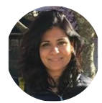
Cheaper, Better, Faster: A Case Study
BA CON
Created by Mansi Anand and Mark Roehl Requirement Analysis Coaches
LinkedIn LinkedIn

Slide 2
Agenda
Introductions
Problem Statement
Plan
Do
Check
Adjust
Takeaways
Questions

Slide 3
Introductions

Slide 4
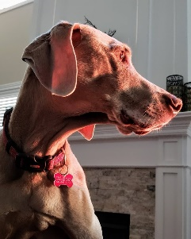
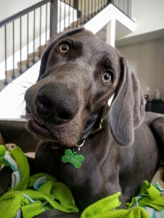
Introductions
Mansi Anand
Program Requirement Lead
Project Requirement Lead
Capability Uplift Consultant
CBAP, SCPM, MACP
Data Analysis certification from CSCC
Notice – no picture. I’m not a sharer
Mark Roehl
Program Requirement Lead
Project Requirement Lead
Capability Uplift Consultant
Line RA Key
CBAP, PMP, Stanford SAPM, Duke ASEP, Certified Scrummaster

Slide 5
Purpose of this Session
At the end of this session, we will talk about best practices and procedures that we incorporated that reduced waste and inefficient processes.
The hope is that these learnings can be brought back to your organization and projects to help you become cheaper, better, and faster.
Notes:
Added this slide as a ‘why’ should anyone bother attending this session…. Perhaps we can go to the write up

Slide 6
Problem Statement

Slide 7
Individual Products & Solutions (IPS) Overview
Provides income protection through life and annuities product development and servicing, all with the goal of delivering on the noble purpose of being there for our members in their times of greatest need.

Slide 8
Individual Products & Solutions (IPS) Problem Statement
Too slooooow to deliver!!
Bulky processes and too many handoffs
Same discussions over and over again
Needed a lean approach to deliver faster, and react to change quickly
Seven development lines across IPS
Notes:
Added 5-7 development lines across IPS to show context

Slide 9
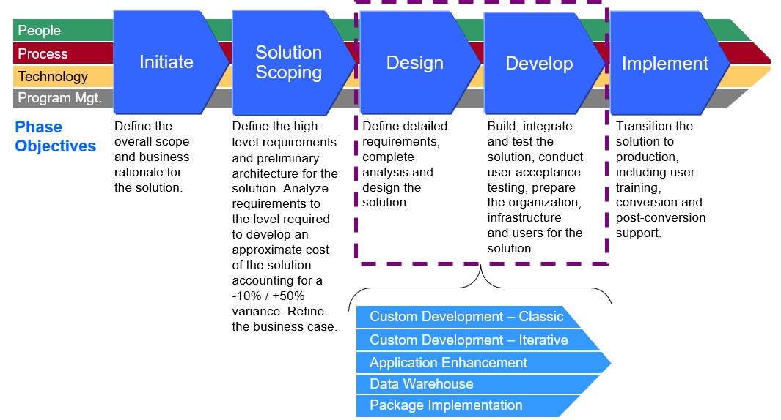
Legacy Nationwide Process

Slide 10
How We Were Engaged
IPS leadership contacted the Analysis Capability Leader assigned to Nationwide Financial who assigned us as Agile Coaches to assist with the identified pain points
Assignment was to confirm problem statement and provide solutions and recommendations
Assigned for a finite amount of time (~4 months)
Notes:
Added timeline. Not sure if it’s helpful

Slide 11
Plan

Slide 12
Plan
Interviewed stakeholders (both IT and Business)
Conducted a survey to identify pain points
Created a measurable baseline

Slide 13
Survey Results (out of 5)
# | Survey Question | Oct
1 | Meeting facilitation is done effectively? | 2.92
2 | The right people are invited and attend the requirement meetings? | 3.24
3 | I understand the requirement schedule/plan? | 2.48
4 | Everyone understands their role in the requirement meetings? | 2.92
5 | Requirements are written effectively? | 2.68
6 | Requirement risks and Issues are communicated and understood? | 2.88
7 | Stakeholders are prepared for the topic of discussion (prep work has been completed beforehand for an effective meeting)? | 2.64

Slide 14
IPS Five Point Plan
Requirement Planning Document
1
Work with each analyst ensuring plan is created and communication plan is followed
Process and documentation Efficiencies
Weekly standup Improvements
5
2
Mark & Mansi to review end-to-end documentation process and look for opportunities and offer recommendations.
Create a weekly standup with Business, PM’s, and other stakeholders to review short term approach and ensure alignment
Training Curriculum
4
3
Meaningful RMA’s
Identify a training curriculum for the analysts to enhance their skillset
Create meaningful requirement management approach by project that is a living document that defines roles and responsibilities.

Slide 15
Do

Slide 16
#1 – Requirement Planning Document Actions
Problem: I understand the requirement schedule/plan?
The right people are invited and prepared for the topic of discussion (prep work has been completed beforehand for an effective meeting)?
A template was created to expedite reuse and consistency between the various lines
All planning documents were complete and sent out to stakeholders
1

Slide 17
#2 – Weekly Standup Improvement Actions
Problem: Requirement risks and Issues are communicated and understood?
Additional stakeholders were added to standups - business leads, PM’s, SME’s
At minimum, additional stakeholders invited to one standup a week
The expectation was set that this should continue going forward
2

Slide 18
#3 – Requirement Management Approach Actions
Problem: Inconsistencies between different lines and RAs
Created overarching IPS Annuity Requirement Management Approach
Identifies guardrails and commonalities all lines should adhere to
IPS Annuity Requirement Management Approach Link
Each line created an RMA that details out the line processes and defines how they operate from an analysis perspective
PALLM Pilots
PALLMistry
PALS
Talk to the PALLM
3

Slide 19
#4 –Training Plan
Problem: Requirements are not written effectively
What
Visual Facilitation Techniques Workshop
The Effective Facilitator
Advanced Facilitation Skills
Agile Story Writing Gherkin Workshop
Advanced Agile
May 1 Fund Updates Teaching Thursday
Annuity Immersion
Teaching Thursday (queries, advanced planning, dashboards) for our tools
Story Mapping
4

Slide 20
#5 – End-to-End Actions
Problem: How can we be more lean reduce waste and deliver faster?
Worked with each line on the end-to-end process
Paired on Iteration Planning Meetings
Coached on Backlog Health
Worked with the lines on the right level of detail on User Stories
Ensured consistency between analysts on the lines
Brought Transparency to the Analysis Space
Created Line Visual Management Boards
Created Dashboards in our tools
Created an analysis dashboard and reuse approach that will serve as a current state repository
5

Slide 21
Check

Slide 22
Check
# | Survey Question | Oct | Jan | +-
1 | Meeting facilitation is done effectively? | 2.92 | 3.20 | 10% (.28)
2 | The right people are invited and attend the requirement meetings? | 3.24 | 3.27 | 1% (.03)
3 | I understand the requirement schedule/plan? | 2.48 | 2.93 | 18% (.45)
4 | Everyone understands their role in the requirement meetings? | 2.92 | 3.07 | 5% (.15)
5 | Requirements are written effectively? | 2.68 | 3.07 | 15% (.39)
6 | Requirement risks and Issues are communicated and understood? | 2.88 | 2.87 | 0% (-.01)
7 | Stakeholders are prepared for the topic of discussion (prep work has been completed beforehand for an effective meeting)? | 2.64 | 2.67 | 1% (.03)
Survey shows improvement in 4 of the 7 target areas
Notes:
4 out of 7 showed meaningful improvement
3 areas for opportunity

Slide 23
Adjust

Slide 24
Adjust the Plan & Execute
Focus on Analysis Planning & Meeting Prep
Transparency to requirement work (30/60/90 day plan)
Focus on Risk and Issue Management
Interviewed PMs, Business, and Scrum Masters
Increased visibility to risks and issues
Incorporating into meeting agendas
Utilized the VMS boards and standup as a tool
Line Backlog Management
Groomed and prepared backlog per business priority.
Drove better Story estimation & planning with Product Owners
Measure Effectiveness through a Final Survey & provide formal recommendation
Final survey sent in March
Notes:
Changed the title
New plan was to focus on the questions that didn’t’ show improvement while reinforcing techniques that worked.
Analysis Planning & Meeting Prep – Meant that we could start planning releases through MVP’s – Bringing speed to the equation on how we can deliver faster and bring value sooner. Also prepared our business partners for what was coming so we could ensure the right people were present.
Risks and issue management – Transparency – Brought quality by being able to mitigate risks earlier and communicate issues helped drive quality and speed by removing blockers
We’re missing how we addressed people understanding their role at meetings….

Slide 25
Final Survey Results (1-5 scale, 5 is fully agree)
# | Survey Question | Oct | Jan | Mar | +- (cumulative)
1 | Meeting facilitation is done effectively? | 2.92 | 3.20 | 3.58 (12%) | 23%
2 | The right people are invited and attend the requirement meetings? | 3.24 | 3.27 | 3.83 (16%) | 18%
3 | I understand the requirement schedule/plan? | 2.48 | 2.93 | 3.25 (11%) | 31%
4 | Everyone understands their role in the requirement meetings? | 2.92 | 3.07 | 3.33 (8%) | 14%
5 | Requirements are written effectively? | 2.68 | 3.07 | 3.75 (22%) | 40%
6 | Requirement risks and Issues are communicated and understood? | 2.88 | 2.87 | 3.42 (19%) | 19%
7 | Stakeholders are prepared for the topic of discussion (prep work has been completed beforehand for an effective meeting)? | 2.64 | 2.67 | 3.42 (28%) | 30%
Post-implementation survey shows improvement in 7 of the 7 target areas
Averaged 17% uplift
Q5. Requirements are written effectively - up 40%

Slide 26
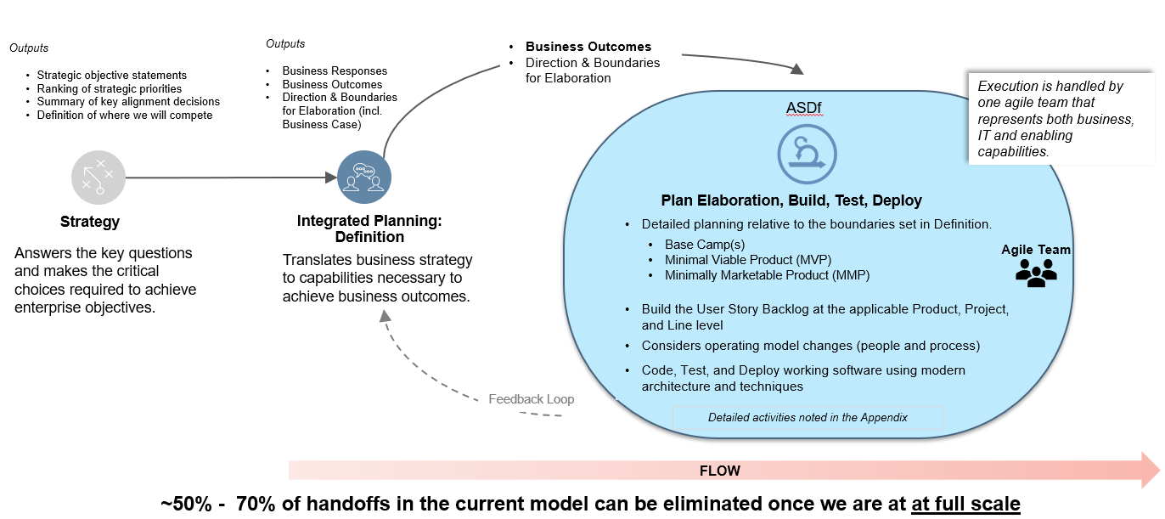
Updated Delivery Model

Slide 27
Takeaways

Slide 28
Tangible Cheaper, Better, Faster Lessons To Takeaway
Visual boards make all the difference
Create a baseline to measure against
No tool trumps communication and collaboration
If there are multiple analysts, ensure there is consistency between the team (common templates)
Handrails not handcuffs
Begin thinking in a 30/60/90 day delivery timeframe – Display visually
Review end-to-end process and eliminate waste
Unleash the power of documenting your processes (RMA)
Create a reusable requirement structure in the requirements tool
Notes:
Visual Boards – Brings transparency to what is being worked on and brings a 30/60/90 day

Slide 29
Takeaways
If we’re not willing to change, we’re going to fail
Trying new approaches needs be embraced
If you fail, learn and improve
Transparency and Communication are key
Don’t be a slave to process
You are empowered to change things for the better

Slide 30
Questions

Slide 31
Questions & Open Discussion

