Slide 1
Mockups for Mobile
Paul Meeker

Slide 2
About Me
Assistant Director, Product Development for Franklin University

Slide 3
Agenda
Franklin Gateway: A Case Study
The Goal
Challenges
Why mockups are important
Refining your mockups
User testing using mockups
Iterate
Exercise: Let’s make an app together!
Q and A

Slide 4
Case Study: Franklin Gateway Mobile App
How mockups were utilized to help define the application

Slide 5
The Goal of the App
Give students mobile access to functionality previously available only on desktop

Slide 6
Challenges
First attempt at the mobile technology (React native)
How do we know what students would want?
How do we determine what should stay on the desktop?
How do we get started?

Slide 7
Value of mockups
Helps you to get started – traction vs. spinning wheels
Promotes shared understanding across various business functions
Becomes your MVP
Can do user-testing without heavy commitment

Slide 8
Start simple
Whiteboard
Pen and paper

Slide 9
Start simple - refine
Powerpoint
Paint
Google drawing

Slide 10
High-fidelity mockups
Sketch (Mac)
Adobe XD
Figma

Slide 11
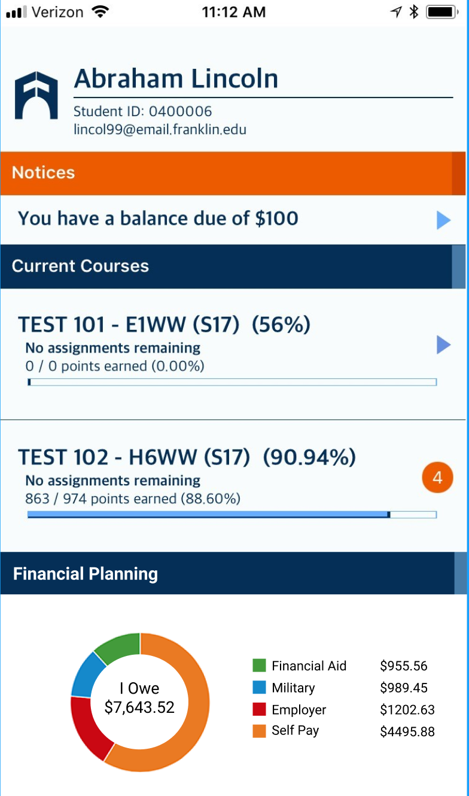
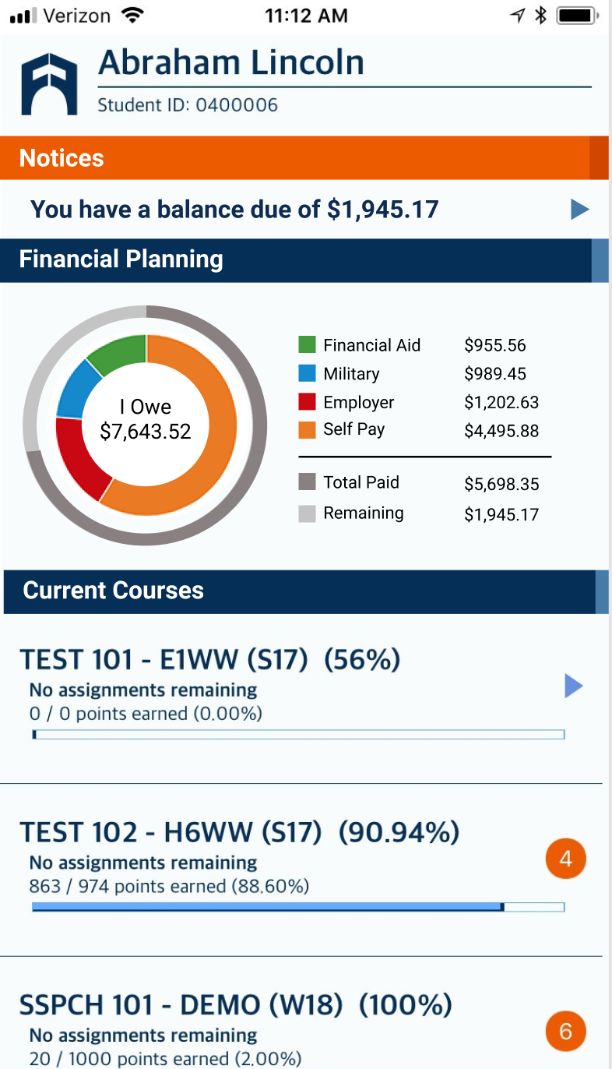
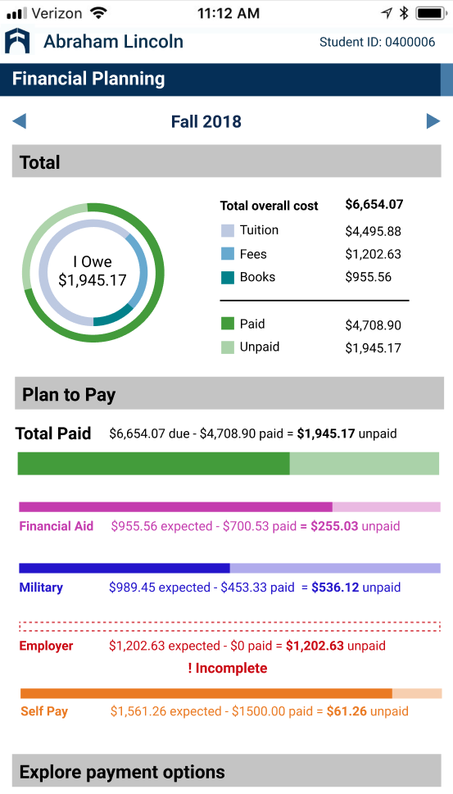
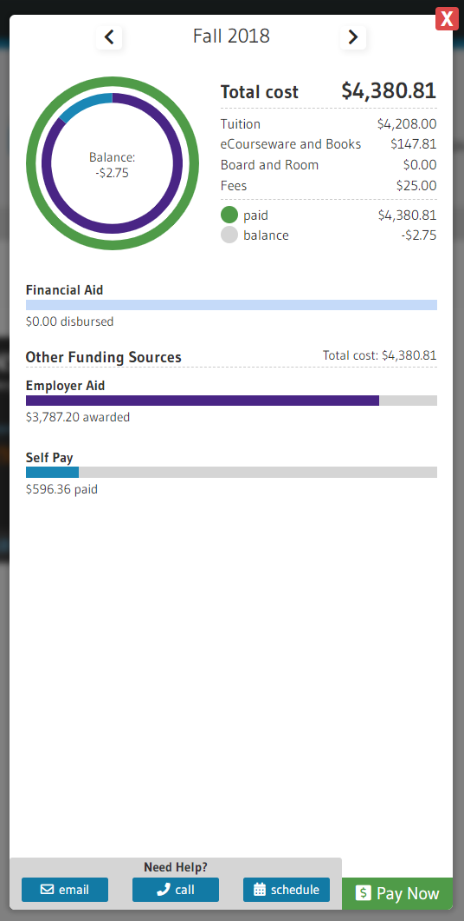
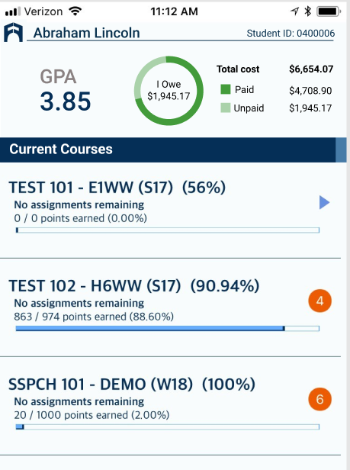
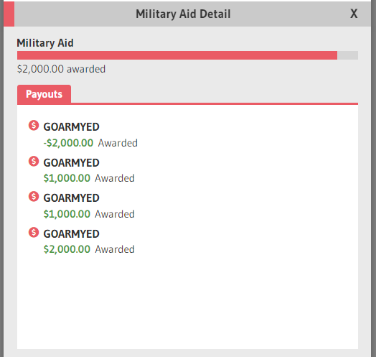
Figma

Slide 12
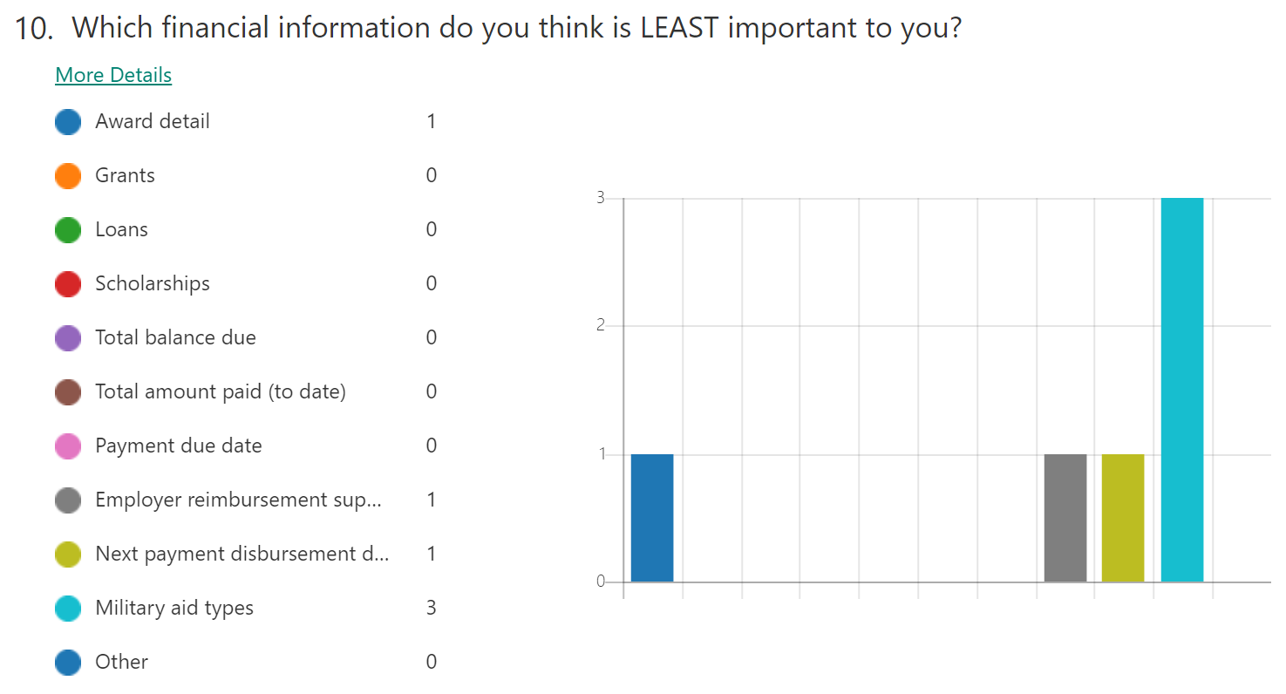
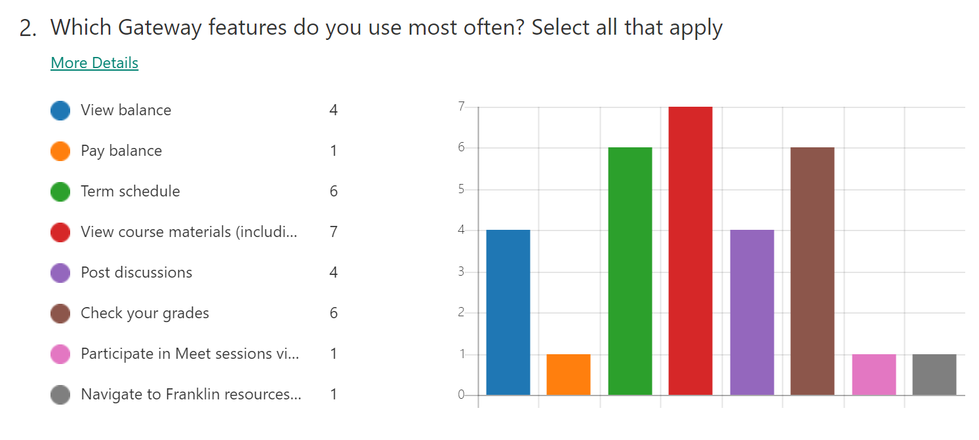
Mockup usability test and survey
https://support.bluequill.com/hc/en-us/articles/360011878014-Financial-Information
https://tinyurl.com/y8ocz2p2

Slide 13
Refine and repeat
Refined high fidelity mockups based on survey results
Measured improvements in future surveys

Slide 14
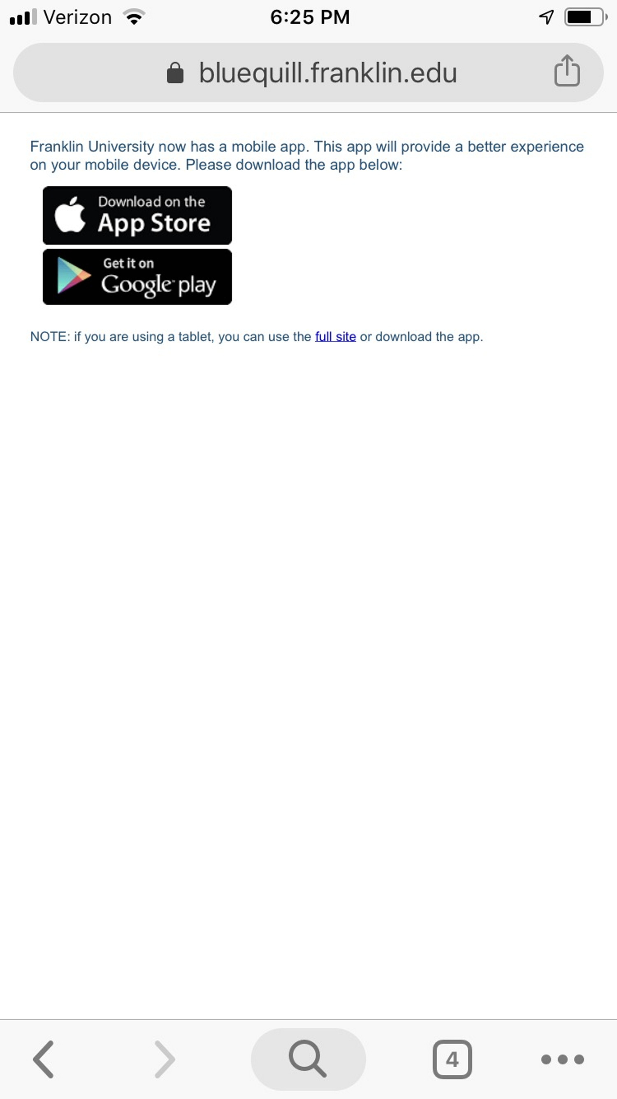
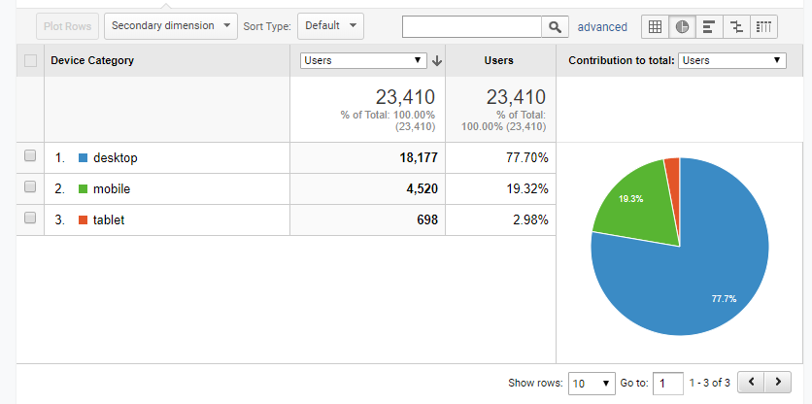
Financial View metrics qualitative and quantitative
Reduction in calls asking about money questions
Call center staff use the same interface that student sees and can more easily answer questions when people do call – increased success rate.
Measurement of clicks into financial view (30% of students in the first month)
Trying to drive mobile browser access number down – going down gradually

Slide 15
Exercise:
Complex desktop experience into mobile
Ideas?
Brainstorm what should be included
Draw it!
Think of good questions we could ask to validate mockup
Refine

Slide 16
Q and A
Earn a Certificate in Business Analysis
Build your knowledge in business analysis in less than 1 year with an Advanced Certificate in Business Analysis from Franklin University.
Get the hands-on training you need to earn certification and get credit toward a bachelor’s degree.
Prepare for the ECBA, CCBA or CBAP exam with a series of four, 12-week online courses. You can also use the 12 hours of transferable credit and get a jump start on the B.S. Information Systems.
Master the industry-standard tools and methods that will make you an asset to any organization
Curriculum follows the Business Analysis Body of Knowledge (BABOK), so you know you are gaining relevant industry knowledge endorsed by the International Institute of Business Analysis (IIBA).
Balance your education and your life with online courses.
Earn your degree 100% online at a nonprofit, accredited university that has been dedicated to educating working adults for more than 115 years.

