Slide 1
How I handled a difficult conversation… and survived to tell the tale!
IIBA BA-CON – August 2019
Photo source: https://www.istudy.org.uk/course/difficult-conversations-how-to-become-a-master-of-them/
Notes:
Photo source: https://www.istudy.org.uk/course/difficult-conversations-how-to-become-a-master-of-them/

Slide 2
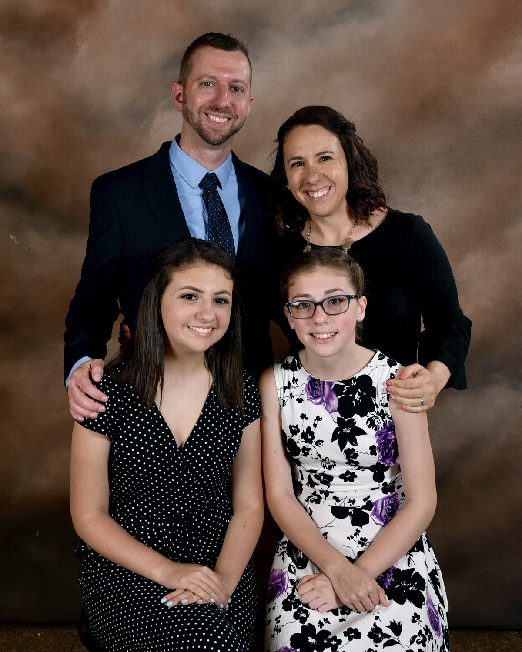
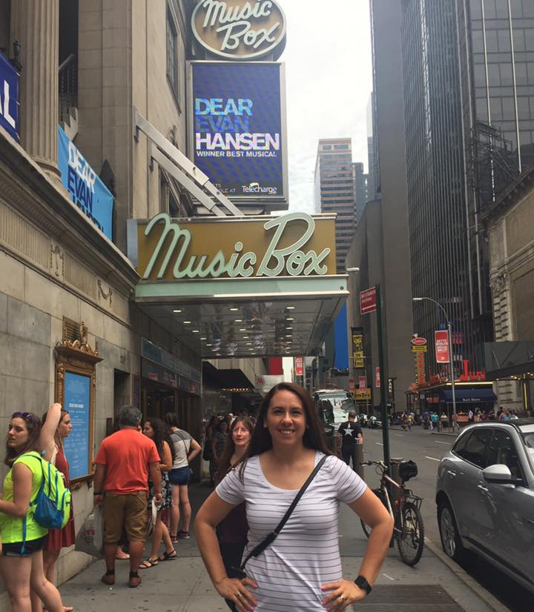
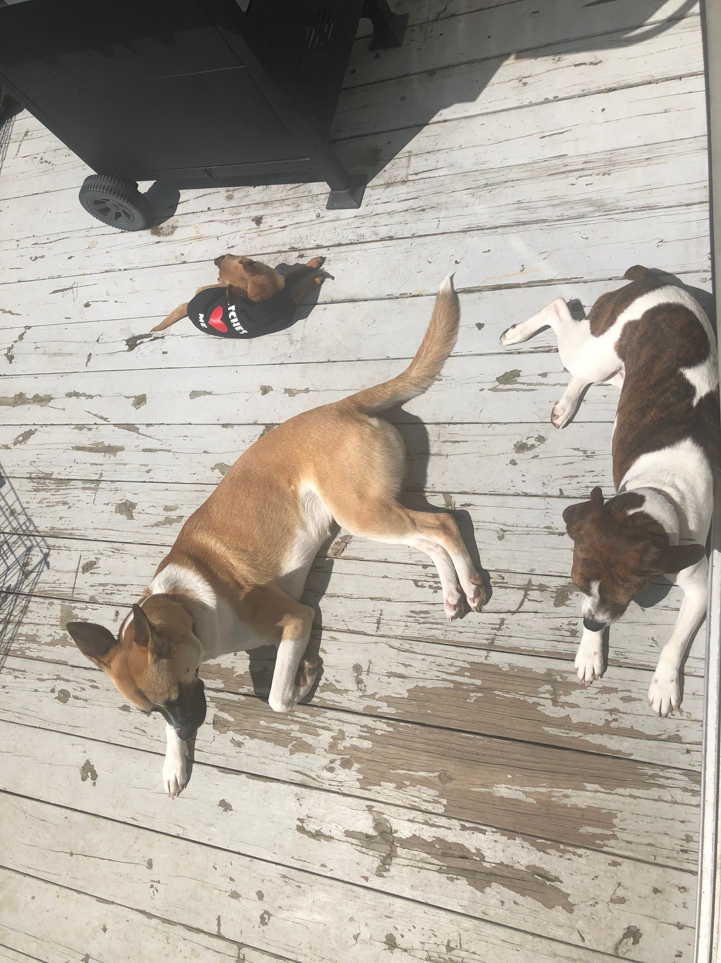
Hello!
Melissa Keesing
Teacher ∙ Coach ∙ Wife ∙ Mom ∙ Dog-Mom ∙ Theatre Nerd

Slide 3
Agenda for today
Crucial Conversation – What is it?
How do we respond and why?
How do we want to respond?
How do I move to action and results?

Slide 4
Photo Source
Do your relationships at work or home always look like this?
Notes:
https://www.themuse.com/advice/the-5-most-important-rules-of-turning-work-relationships-into-real-friendships

Slide 5
Photo Source
How often do they actually look like this?
Notes:
http://www.agileadvice.com/2015/07/15/referenceinformation/pitfall-of-scrum-problem-solving-in-the-daily-scrum/

Slide 6
Photo Source
Notes:
https://www.cbc.ca/news/canada/british-columbia/jennifer-newman-psychologist-tell-us-how-to-deal-with-rude-co-workers-1.3155641

Slide 7
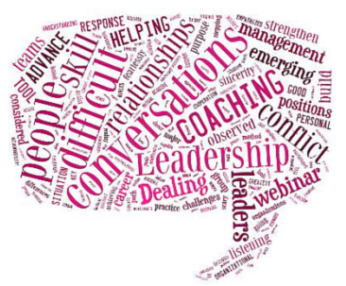
Why do we have such a hard time handling difficult conversations?
Notes:
Our approach is flawed!
We avoid conversations where we keep getting stuck
We fail to notice when safety is at risk
You don’t know how to make it safe for touchy subjects
We don’t know what to do when others blow up
We turn to our worst behaviors vs our best
We fail to turn these conversations in to action

Slide 8
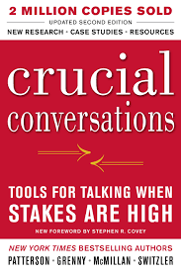
The 7 Crucial Conversations Principles
Start with Heart
Learn to Look
Master Your Stories
Make It Safe
Get the right focus.
Know when it’s unsafe
Stay in dialogue despite negative feelings
Facilítate an open dialogue
State Your Path
Explore Others’ Path
Move to Action
Share your views persuasively
Be a Good Listener
Convert dialogue to results
Notes:
Almost all of this talk is based on the concepts found in this book.
These are the 7 principles that the book is founded on and we will attempt to touch on each of these.

Slide 9
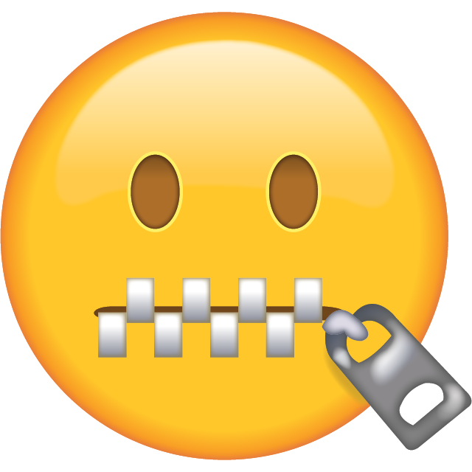
How do people generally respond?
SILENCE
Withdrawing
Avoiding
Masking
DIALOGUE
VIOLENCE
Controlling
Labeling
Attacking
We either don’t handle the conversation or we don’t handle it well.
Source: “Crucial Conversations – Tools for talking when stakes are high” from authors Kerry Patterson, Joseph Grenny, Ron McMillan and Al Switzler
Notes:
Toggle back and forth between two ends of an unhealthy spectrum.
We may hold things inside by going silent until we can no longer take it anymore – then we toggle to the other end.
We may not get physically violent but we will attach people’s ideas and feelings.
We either don’t handle the conversation or we don’t handle it well.

Slide 10
Why do people respond as they do?
Human Physiology is working against our best efforts!!
Complex interactions with no notice are hard ☹
Our motive is what degrades first, not our behavior.
Source: “Crucial Conversations – Tools for talking when stakes are high” from authors Kerry Patterson, Joseph Grenny, Ron McMillan and Al Switzler
Notes:
Human physiology
Reptilian brain
HBR article on psychological safety that speaks to why we respond this way
Brain processes a provocation
The amygdala (alarm bell in the brain) ignites your fight or flight response
Analytical reasoning shuts down; so we quite literally lose our minds; our strategical thinking is handicapped
Caught by surprise
In these moments we are required to process a complex interaction with no notice
We make it worse!
We turn to our worst behavior instead of our best intentions
Our motive is what degrades first, not our behavior
It’s important to stay focused on what you really want.

Slide 11
How do we want to respond?
Recognize you’re in a crucial conversation.
What do I do once I am in a crucial conversation?
The crucial conversation happened; now what?
Source: “Crucial Conversations – Tools for talking when stakes are high” from authors Kerry Patterson, Joseph Grenny, Ron McMillan and Al Switzler
Notes:
What do I really want? I can’t be in it to win

Slide 12
What is a Crucial Conversation?
crucial
conversation
Opposing Opinions
Strong Emotions
High Stakes
Source: “Crucial Conversations – Tools for talking when stakes are high” from authors Kerry Patterson, Joseph Grenny, Ron McMillan and Al Switzler
Notes:
All of these elements must be in place for it to be a crucial conversation.
Why are we talking about this in relation to agile and your teams?

Slide 13
When a discussion starts to become stressful, we often end up doing the exact opposite of what works.
Dialogue
You are not self-aware.
You react poorly.
You are self-aware after it occurs.
You react poorly.
You are self-aware in the moment.
You avoid reacting poorly!
You can avoid reacting poorly by learning to look for:
When things become crucial
Safety problems in the conversation
When you move to silence or violence
Do you know your style under stress?
Source: “Crucial Conversations – Tools for talking when stakes are high” from authors Kerry Patterson, Joseph Grenny, Ron McMillan and Al Switzler
Notes:
Make it safe
When caught up in a crucial conversation, it’s difficult to see exactly what’s going on and why. When a discussion starts to become stressful, we often end up doing the exact opposite of what works. We turn to the less healthy components of our style under stress. To break from this cycle it’s important to LEARN TO LOOK:
Learn to look at content and conditions
Look from when things become crucial
Learn to watch for safety problems
Look to see if others are moving toward silence or violence
Look for outbreaks of your style under stress
NEXT -- Rebuild safety as needed – what are you looking for? ACTIVITY – What signs to look for in myself.

Slide 14
Activity/Discussion:
What signs do I need to look for in myself that compromise safety in dialogue?
+ debrief
Notes:
Activity of four question worksheet
What emotions do you feel during crucial conversations?
What physical responses do you notice?
How do you tend to behave?
How can you use this knowledge?
Write down your feelings in the moment to avoid speaking them out loud.

Slide 15
How do you act and feel in Crucial Conversations?
5 min

Slide 16
What if I missed signs that healthy dialogue is at risk?
Apologize when you have clearly violated respect
Clarify and remain aware of your intent
Commit to search for a goal that will benefit both of you…or find as much common ground as possible
Be genuine in your approach
Source: “Crucial Conversations – Tools for talking when stakes are high” from authors Kerry Patterson, Joseph Grenny, Ron McMillan and Al Switzler
Notes:
So how do we make it safe when you miss signals that a conversation is becoming unsafe?
What if we know what to look for and miss the signals?
Here is what to consider when you feel like safety is at risk in your conversation:
If you see someone moving to silence or violence, step out of the conversation. Once safety is restored, re-enter to tackle the dialogue – courage: I want to respond more effectively
Apologize when you have clearly violated respect – respect the person and the conversation
Clarify and remain aware of your intent - Focus
Help people see that you genuinely care and commit to seek mutual purpose; be genuine in your approach – openness
If you aren’t living the 5 values, then you can’t have a productive conversation and be aware of crucial conversation!

Slide 17
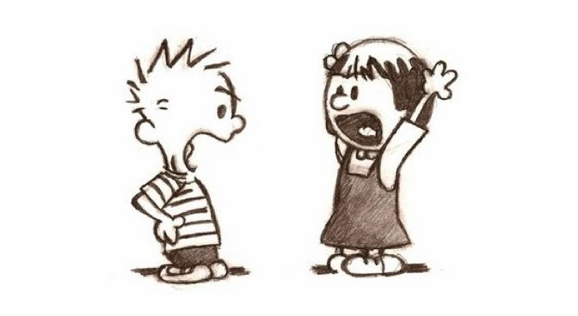
Notes:
When it matters most and our emotions kick in, we often do our worst.

Slide 18
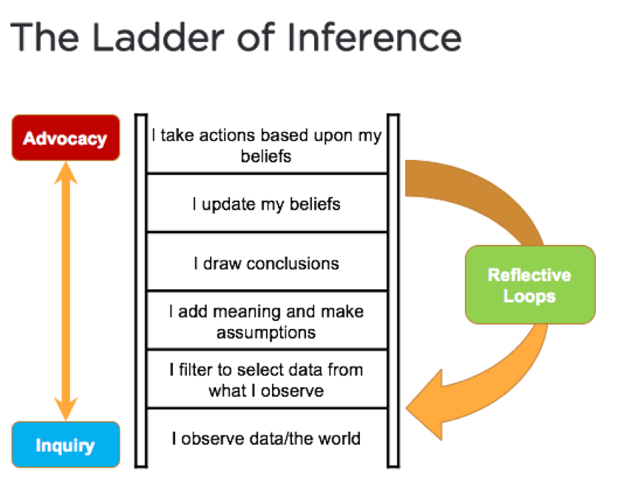
How to stay in dialogue when you are angry, scared, or hurt
Retrace your path to determine how you arrived to the reasoning or conclusion you have
Beware of assumptions and jumping to conclusions
Understand facts from feelings
Source: “Crucial Conversations – Tools for talking when stakes are high” from authors Kerry Patterson, Joseph Grenny, Ron McMillan and Al Switzler
Notes:
I’m at my worst…
How do you create emotions that make you want to return to healthy dialogue?
Master my stories – how to stay in dialogue when you are angry, scared, or hurt
Our stories create our emotions; we create our stories
Retrace your path – if you are moving away from content, retrace your steps and notice your behavior
Analyze your stories and question your conclusions
Get back to the facts!
ACTIVITY – Data vs Facts (bring a scenario to use during session)

Slide 19
Activity:
Facts vs. Feelings
+ debrief
Notes:
Provide 2-column worksheet

Slide 20
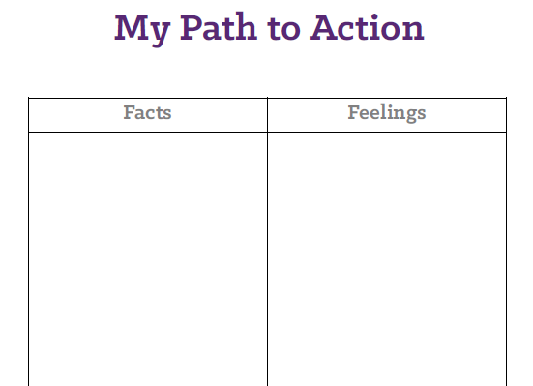
1
Think of a difficult conversation:
That has happened that didn’t go very well, or
Needs to happen
2
Think of at least 1-2 facts and 1-2 feelings related to the scenario above. Document them on your worksheet.
Team member has arrived late to our daily Scrum 3 times this week
Our team agreements say we agree to be on time for meetings as a team
Team members have approached me about this thinking you’ve stopped caring
They are frustrated about what appears to be this person’s lack of respect for everyone’s time
5 min

Slide 21
During Crucial Conversations, do you say things in the wrong way?
Speak persuasively, not abrasively.
Learn a way to say risky things in a way that minimizes defensiveness -- STATE your path.
Share your facts
Tell your story
Ask for other’s paths
Talk tentatively
Encourage testing
“What” skills
“How” skills
Source: “Crucial Conversations – Tools for talking when stakes are high” from authors Kerry Patterson, Joseph Grenny, Ron McMillan and Al Switzler
Notes:
STATE my path
Share your path – tell your facts succinctly
Tell your story – Talk about how it made you feel
Ask for others’ path – “Did I get that right?” CHECK FOR UNDERSTANDING
Talk tentatively – Listen and be genuine
Encourage testing – Discuss the best way to move forward – Inspect & Adapt!

Slide 22
10 min
Activity:
Turn my “Facts vs. Feelings” in to dialogue
+ debrief

Slide 23
Share your facts
Tell your story
Ask for other’s paths
Talk tentatively
Encourage testing
“What” skills
“How” skills
Source: “Crucial Conversations – Tools for talking when stakes are high” from authors Kerry Patterson, Joseph Grenny, Ron McMillan and Al Switzler
Notes:
STATE my path
Share your path – tell your facts succinctly
Tell your story – Talk about how it made you feel
Ask for others’ path – “Did I get that right?” CHECK FOR UNDERSTANDING
Talk tentatively – Listen and be genuine
Encourage testing – Discuss the best way to move forward – Inspect & Adapt!

Slide 24
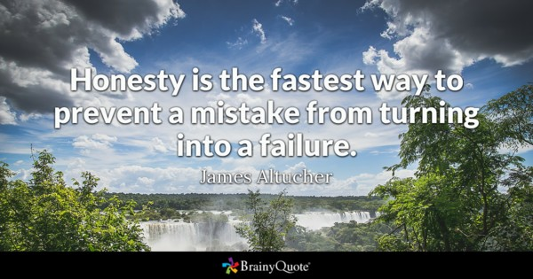
Notes:
You can’t be too honest – make it safe and you can talk about almost anything.
When it comes to safety, it’s all about intent. If your intent is pure, you can talk candidly.
Don’t water down your message or avoid the conversation when things go wrong in crucial conversations.
So imagine this – it is now possible to hold any conversation that before you assumed you couldn’t hold.

Slide 25
What happens when healthy dialogue doesn’t feel possible?
A
Ask to get things rolling
Mirror to confirm feelings
Paraphrase to acknowledge the story
Prime when you’re getting nowhere
“Please let me know how you see it differently.”
M
Explore others’ path with AMPP
“You say you’re ok, but by the tone of your voice, you seem upset.”
P
“So what you’re saying is…” [Don’t just parrot back.]
P
“Do you think that…?” [where you offer your best guess to what’s wrong.]
Source: “Crucial Conversations – Tools for talking when stakes are high” from authors Kerry Patterson, Joseph Grenny, Ron McMillan and Al Switzler
Notes:
When others move to silence or violence we need to encourage them to retrace their path to action to its source. When others are sharing feelings or acting inappropriately, its our job to make it safe for them to share their facts.
Be willing to listen – AMPP
ASK TO GET THINGS ROLLING – ask for their views; find the source of their feelings and be genuine
MIRROR TO CONFIRM FEELINGS – use this skill when someone’s action or body language don’t match what they say (“I’m fine” but arms are crossed – be specific with your observations). [TRANSPARENCY]
PARAPHRASE TO ACKNOWLEDGE THE STORY – NOT parroting back; it shows that you are genuinely listening and saying “I’m interested in what you are saying.”
PRIME WHEN YOU’RE GETTING NOWHERE – helping someone articulate their POV by providing your best guess as to their feelings to help someone more out of silence. It’s a risky move because you are making a guess. Best to use it last.
Why would you use AMPP?
Create safety
Don’t look to disprove; look for what is true
Be patient
Adrenaline
Slowly and Carefully listen
You have to be ready for what the other person says or does

Slide 26
How to turn Crucial Conversations in to action and results
Who will do
What by
When (and what)
Follow-up will be taken
Agree on WWWF
Hold one another accountable.
Incorporate crucial conversation skills in to your daily life.
Following up is important if you expect a change in behavior to be consistent.
As leaders, we owe it to ourselves and to our team mates to step up to moments of crucial conversations.
Source: “Crucial Conversations – Tools for talking when stakes are high” from authors Kerry Patterson, Joseph Grenny, Ron McMillan and Al Switzler
Notes:
EMPIRICAL PROCESS – TRANSPARENCY – INSPECT – ADAPT
COMMIT TO DO IT
There are two steps that the most influential people take at the end of a crucial conversation that help them move to action and results rather than violated expectations and déjà vu dialogues.
Agree on WWWF – Document who will do what by when and what follow-up action will be taken. Then follow-up.
Hold one another accountable. Have the courage to deal with team conflict head-on and respect each other enough to discuss it and make it transparent. Commit to helping each other to be more self-aware.
Incorporate crucial conversation skills in to your daily life. Encourage experimentation/test & learn.

Slide 27
What I’ve learned about Crucial Conversations over the years
Regardless of my available tool set, every conversation is still difficult
I can still be bad at it, but the more I do it, the better I get.
If your concern isn’t genuine, people can see right through it. Trust will break down.
Following up is important if you expect a change in behavior to be consistent.
As leaders, we owe it to ourselves and to our team mates to step up to moments of crucial conversations.

Slide 28
Thank you. Melissa Keesing Find me at Melissa.Keesing@insight.com
Thank you for coming!

